Slide 1
Welcome! Google Cloud Certification Workshop— Data Engineer

Slide 2

The following course materials are copyright protected materials. They may not be reproduced or distributed and may only be used by students attending the Google Cloud Certification Workshop—Data Engineer course.

Slide 3


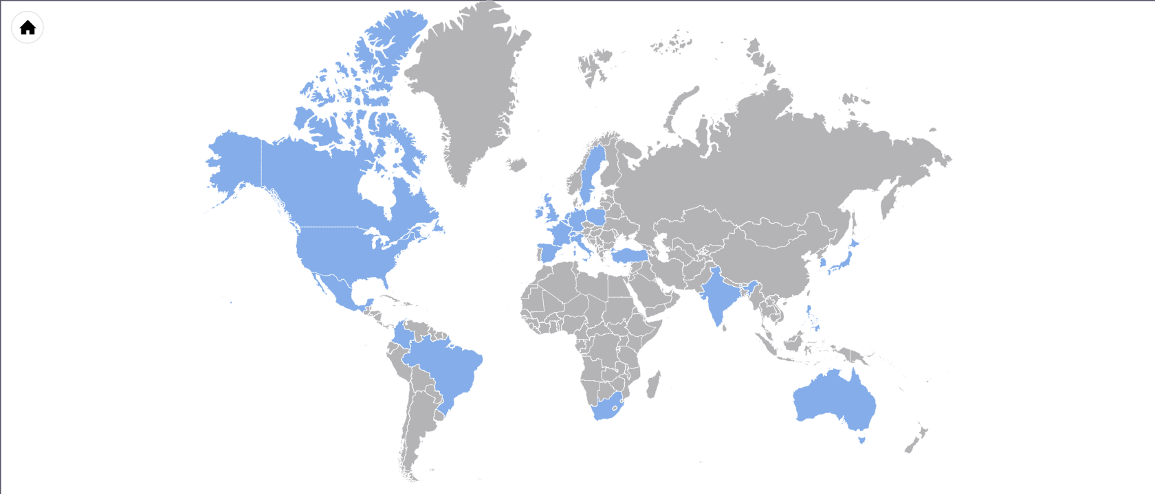

Most recognized, experienced Google Cloud Premier Partner
20,000 people trained in 30+ countries across 6 continents
Largest team of Google Cloud Platform Certified Instructors
Helped more IT professionals achieve Google Cloud Platform certification than any other partner
google.roitraining.com

Slide 4
Course Versions
This course is offered in several versions and durations
The delivery will vary depending on the duration
For example:
Hands-on exercises are normally provided for experience and as extra practice to be done outside of class hours
Some versions of the class will perform the exercises during class hours

Slide 5
Google Cloud Certification Workshop—Data Engineer
Introduction

Slide 6
Course Objectives
In this course, we will learn how to:
Prepare for the GCP Data Engineer certification exam
Choose the appropriate GCP data storage solution
Architect batch and streaming data processing pipelines on GCP
Leverage GCP tools for data manipulation, analysis, and visualization
Build machine learning models with GCP tools
Analyze case studies to optimize data storage and processing solutions

Slide 7
Prerequisites for the Exam
The exam tests one’s understanding of how to design, build, and maintain secure, reliable data processing systems on Google Cloud Platform
Experience with Google Cloud Platform at the level of course Data Engineering on Google Cloud Platform
Real-world experience using Google Cloud Platform

Slide 8
The Course Workbook
The course materials are written as a workbook
Make a copy by:
Going to the URL: https://goo.gl/F3aCBb
In Google slides, choose File | Make a Copy
This allows you to edit the course materials and do the activities provided

Slide 9
Google Cloud Certification Workshop—Data Engineer
Chapter 1:
Data Engineer Certification Overview

Slide 10
Chapter Objectives
In this chapter, we will:
Review the certification exam format and guidelines

Slide 11

Chapter Concepts
Exam Overview
Exam Prep

Slide 12
What Is a Data Engineer’s Job?
As a class, let’s come up with a list of things a data engineer would need to do or understand
Notes:
Answers might include:
Data modeling
Database administration
Data analysis
Choosing data storage services
etc

Slide 13
What You Are Tested On
You are not tested on trivia (what is the maximum number of this or that)
You are not required to code or configure a service
You are tested on your ability to:
Build storage solutions on Google Cloud Platform
Architect storage and processing systems using GCP services
Transform data for efficient analysis and machine learning
Analyze and visualize data using GCP tools
Can you choose which services to use for various cases optimizing:
Cost, performance, security, fault-tolerance, etc.

Slide 14
Exam Format
Multiple-choice questions
Some are single select
Some are select 2 or 3
Some questions are based on a case study
In class, you will study the case studies
You have 2 hours to take the exam
Time should not be a problem if you are prepared
Grading is Pass/Fail

Slide 15
Taking the Exam
Must register to take the exam
Exam must be taken in-person at a Kryterion testing center location
Bring 2 forms of ID
Exam fee is $200

Slide 16
Chapter Concepts
Exam Overview
Exam Prep

Slide 17
Do Now: Understanding the Exam
Take a few minutes to read the following pages:
https://cloud.google.com/certification/data-engineer
https://cloud.google.com/certification/faqs
https://cloud.google.com/certification/guides/data-engineer/

Slide 18
Google Cloud Certification Workshop—Data Engineer
Chapter 2:
Google Storage Fundamentals

Slide 19
Chapter Objectives
In this chapter, we will learn how to:
Choose the right storage solution based cost, availability, durability, and consistency
Differentiate GCP’s storage products by use case
Architect data processing solutions using GCP storage services

Slide 20
Chapter Concepts
Storage Overview
GCP Storage Options
Architecting Data Processing Solutions
Exam Prep

Slide 21
Do Now: Types of Data
Below, list different types of data you need to store
Notes:
Answers might include:
Binary files
Text files
Structured data
Relational data
Programs
Code
etc.

Slide 22
Do Now: Data Storage Considerations
In addition to the type of data, list other considerations you should consider when choosing an appropriate storage option?
Notes:
Answers might include:
Amount of data
Multiple users?
Security
Use(s) of the data

Slide 23
Choosing Data Storage Solutions
The right storage solution depends on many factors
What type of data are you storing?
Images, videos, relational, text, code, etc.
How much data do you have?
How you store MBs of data is different than how you would store PBs
What are the security requirements?
Public data distributed online
Sensitive personal information
How will you process the data?
Is it multi-user data?
Etc.

Slide 24
Storage Cost
Cost varies widely depending on the storage solution
In general, storage services designed for large amounts of data are less expensive per GB than those designed for smaller amounts
Knowing how storage services are priced, helps determine which to use

Slide 25
Availability and Durability
Availability is the percentage of time the data can be accessed
Achieved by deploying services to multiple zones and/or regions
Durability defines the likelihood of losing data because of a hardware failure
Achieved by writing data to multiple physical disks
The more disks, the higher the durability

Slide 26
Do Now: Cost vs. Availability vs. Durability
Fill in the table below:
Scenario | Use Cases
High availability is the most important consideration
Cost and durability are more important than availability
Cost is the only consideration
Notes:
High availability: Delivering Web content might be an example
Cost and durability: Backups, disaster recovery, archives
Cost: Caching might be an example of when cost is more important than avail and dur. Memcache for example is free, but the cached data might go away and have to be recreated.

Slide 27
Consistency
Transactional consistency – When a transaction completes, all operations must be successful or all are rolled back
The data must conform to all rules specified by the database
The state of data is known by all nodes in a distributed system
Eventual consistency – After data is updated, the system guarantees that all copies of the data in a distributed system will “eventually” be the same
It is possible that requests to different nodes will return different results after an update
Strong eventual consistency – All nodes in a distributed system that have received the same updates will be in the same state

Slide 28
Data Warehousing
Combines data from multiple sources
Relational databases
Logs
Web data
Etc.
Allows data from multiple sources to be combined and analyzed
Historical archive of data

Slide 29
Chapter Concepts
Storage Overview
GCP Storage Options
Architecting Data Processing Solutions
Exam Prep

Slide 30

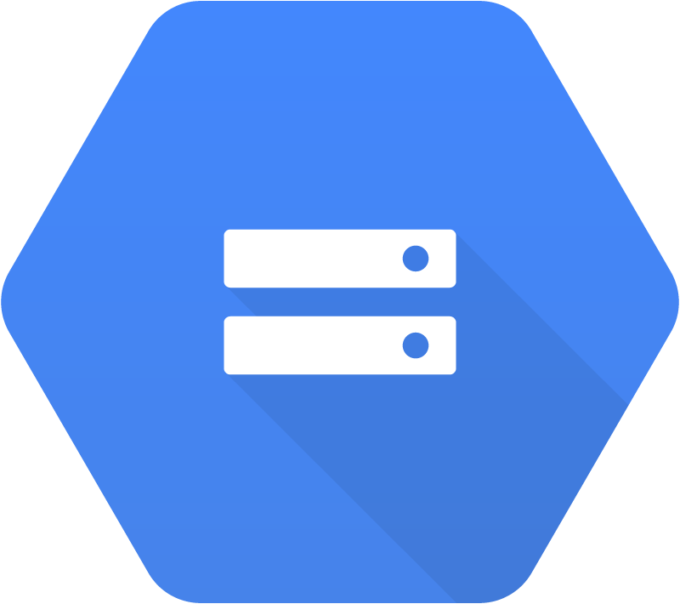




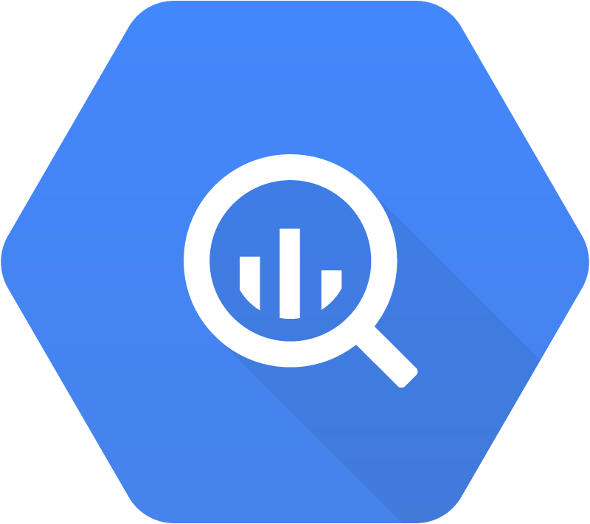
Google’s Storage Service Choices
Persistent
Disks
Cloud Storage
Cloud SQL
Spanner
Datastore
BigTable
BigQuery

Slide 31
Choosing a Storage Service
Choose your storage service based on your use case
Balance, cost, availability, durability, consistency, scalability
Know the characteristics of the different services

Slide 32
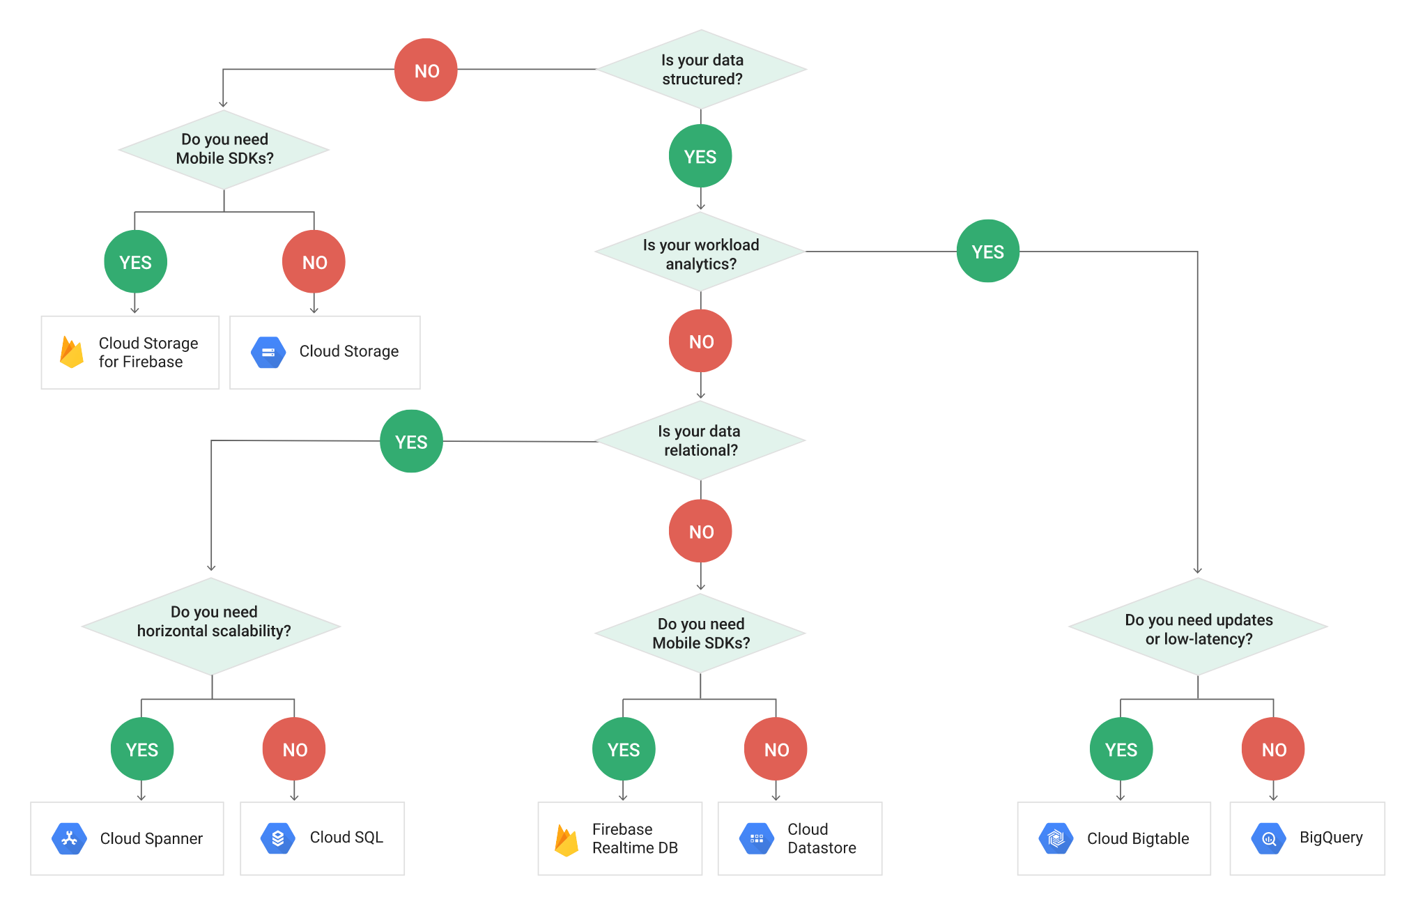
Do Now: Choosing the Right Storage Service
Visit the Choosing a Storage Option link
Examine the flowchart on choosing a storage option
Read the table that describes the various storage options and their use cases

Slide 33
Chapter Concepts
Storage Overview
GCP Storage Options
Architecting Data Processing Solutions
Exam Prep

Slide 34
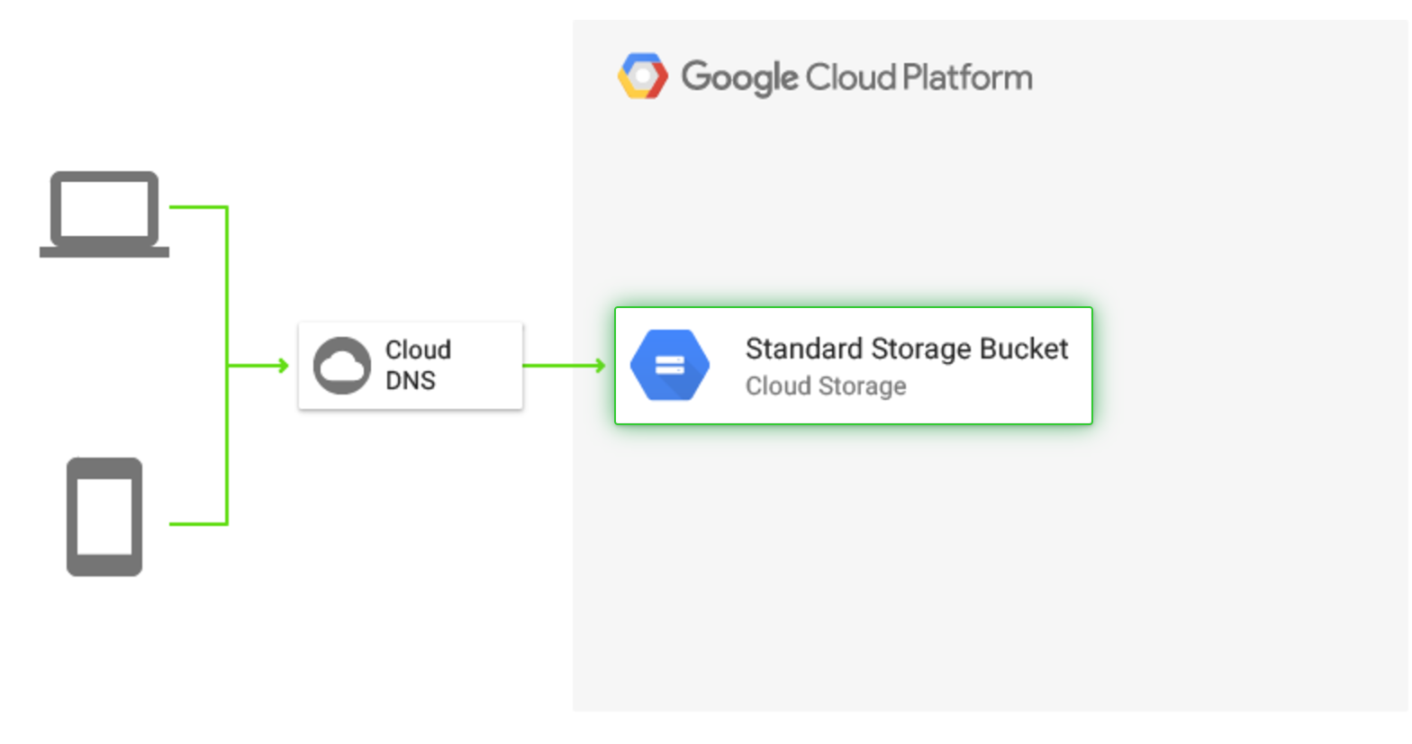
Static Websites
http://gcp.solutions/diagram/Static%20Hosting

Slide 35
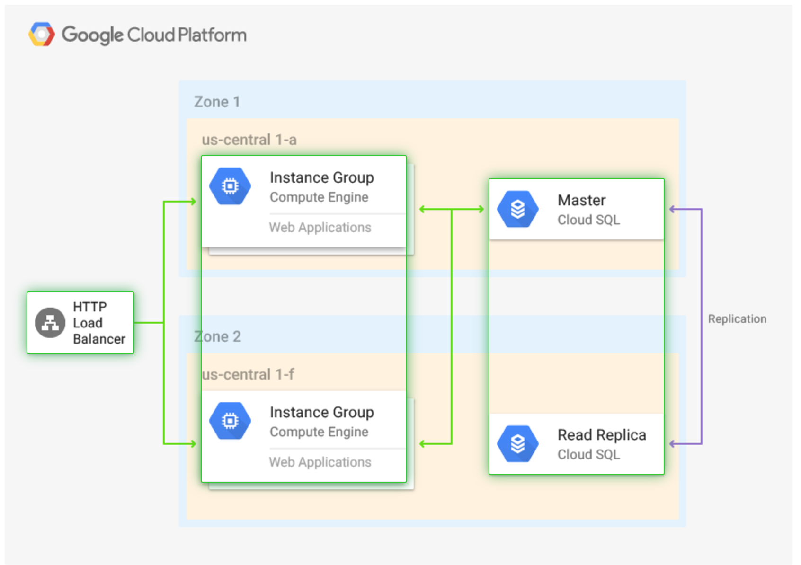
Dynamic Web Applications
http://gcp.solutions/diagram/Dynamic%20Hosting

Slide 36
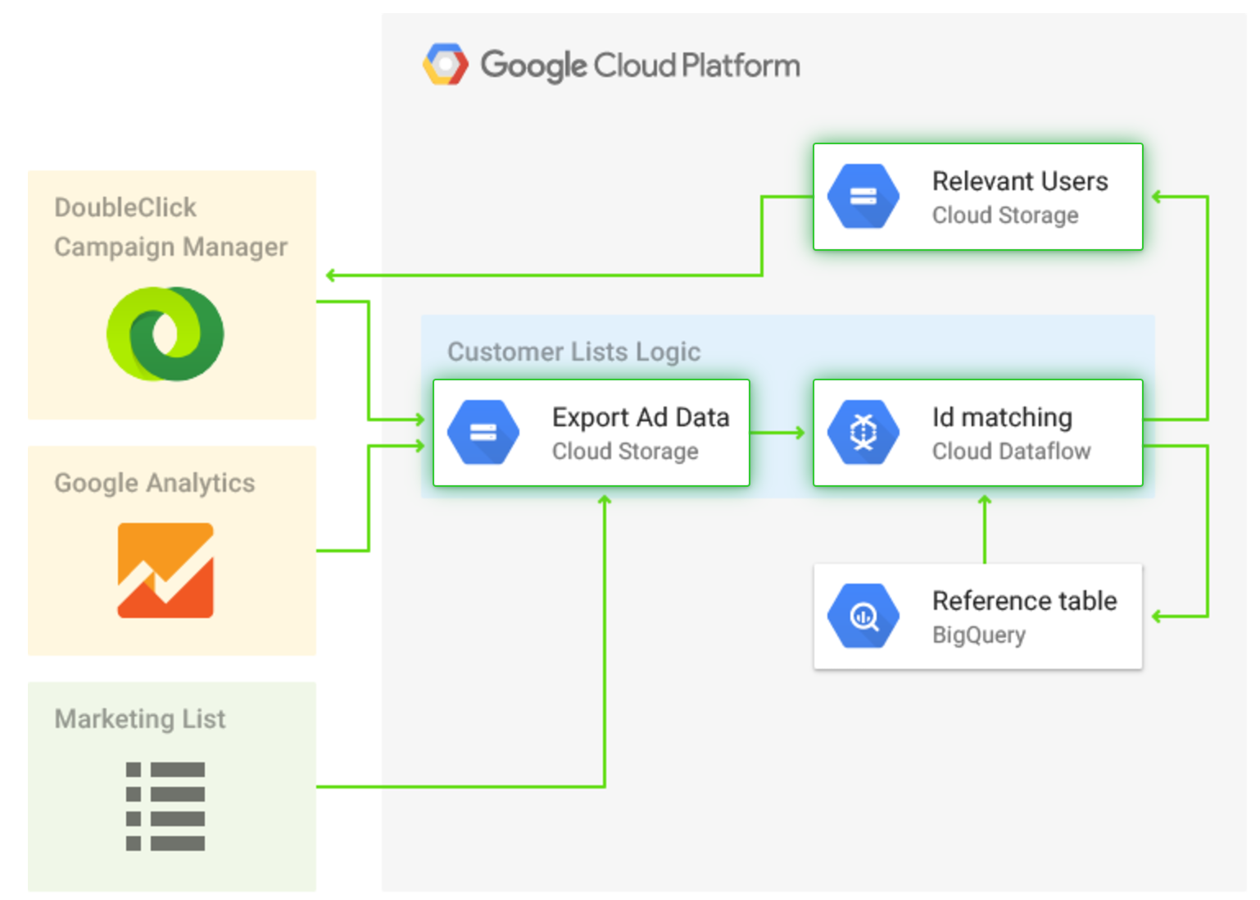
Data Warehousing
http://gcp.solutions/diagram/DMP%20%2F%20Data%20Warehouse

Slide 37
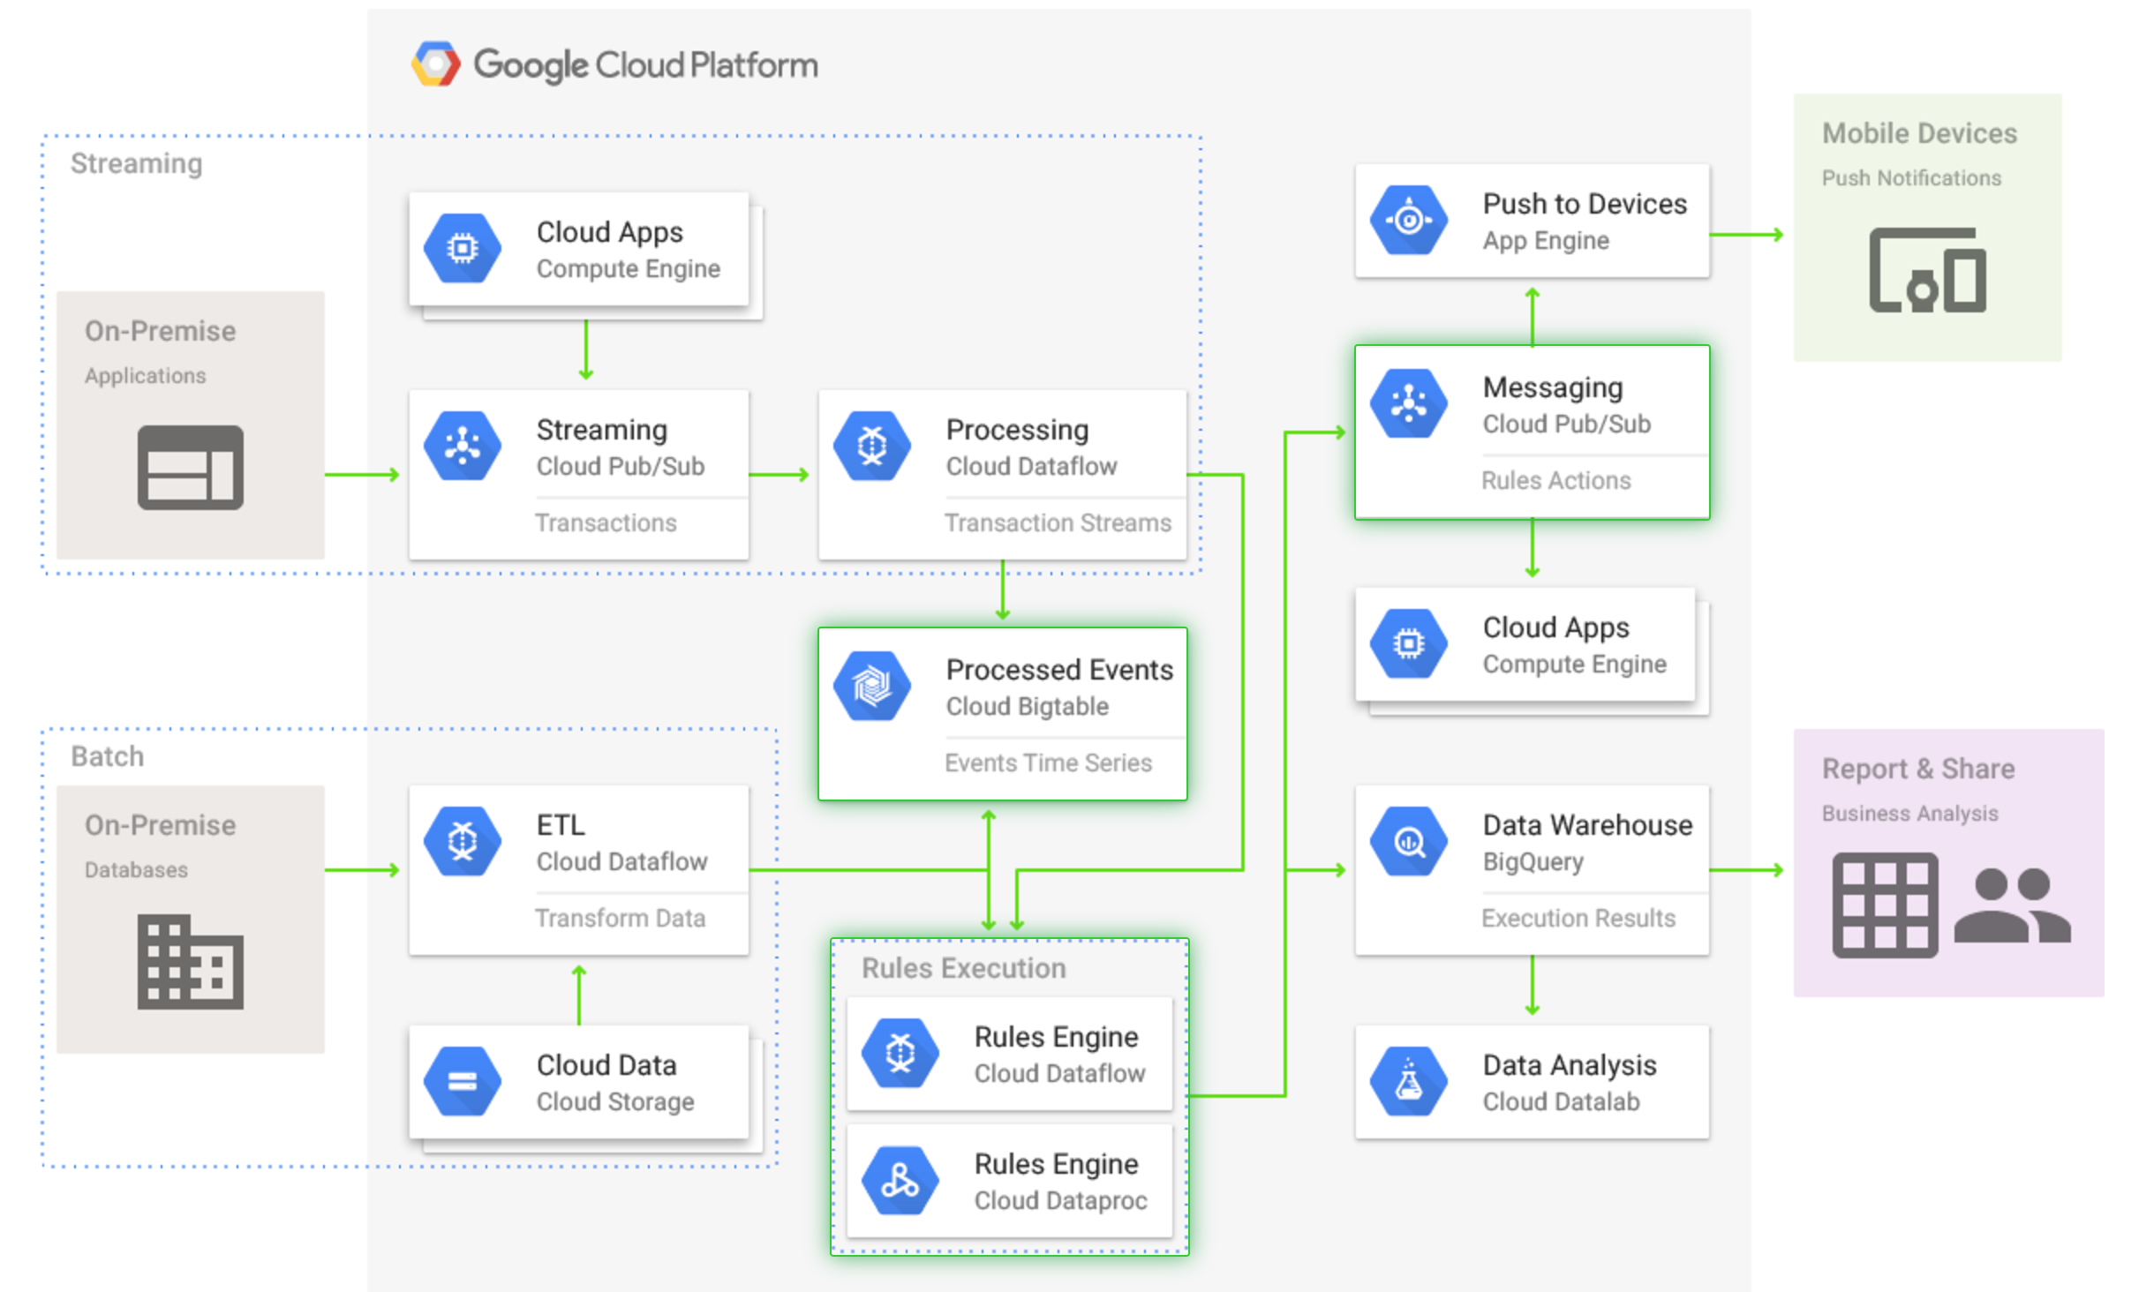
Event Processing
http://gcp.solutions/diagram/Complex%20Event%20Processing

Slide 38
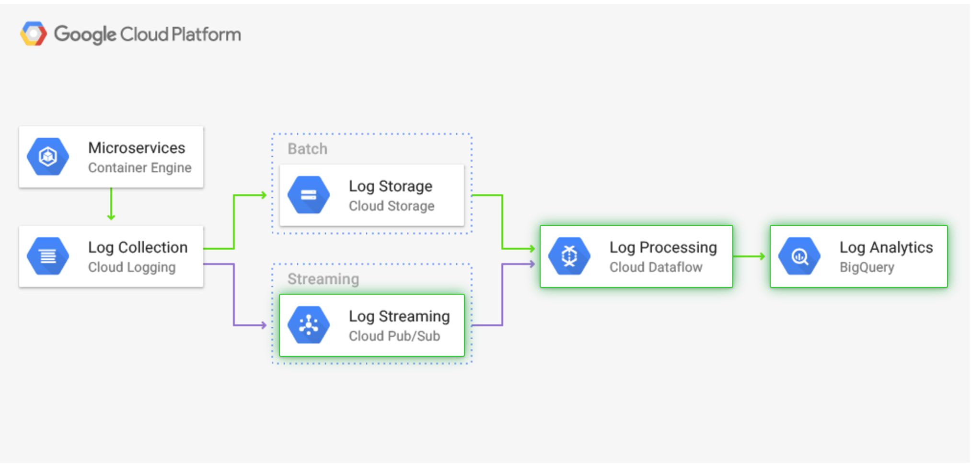
Log Processing
http://gcp.solutions/diagram/Log%20Processing

Slide 39
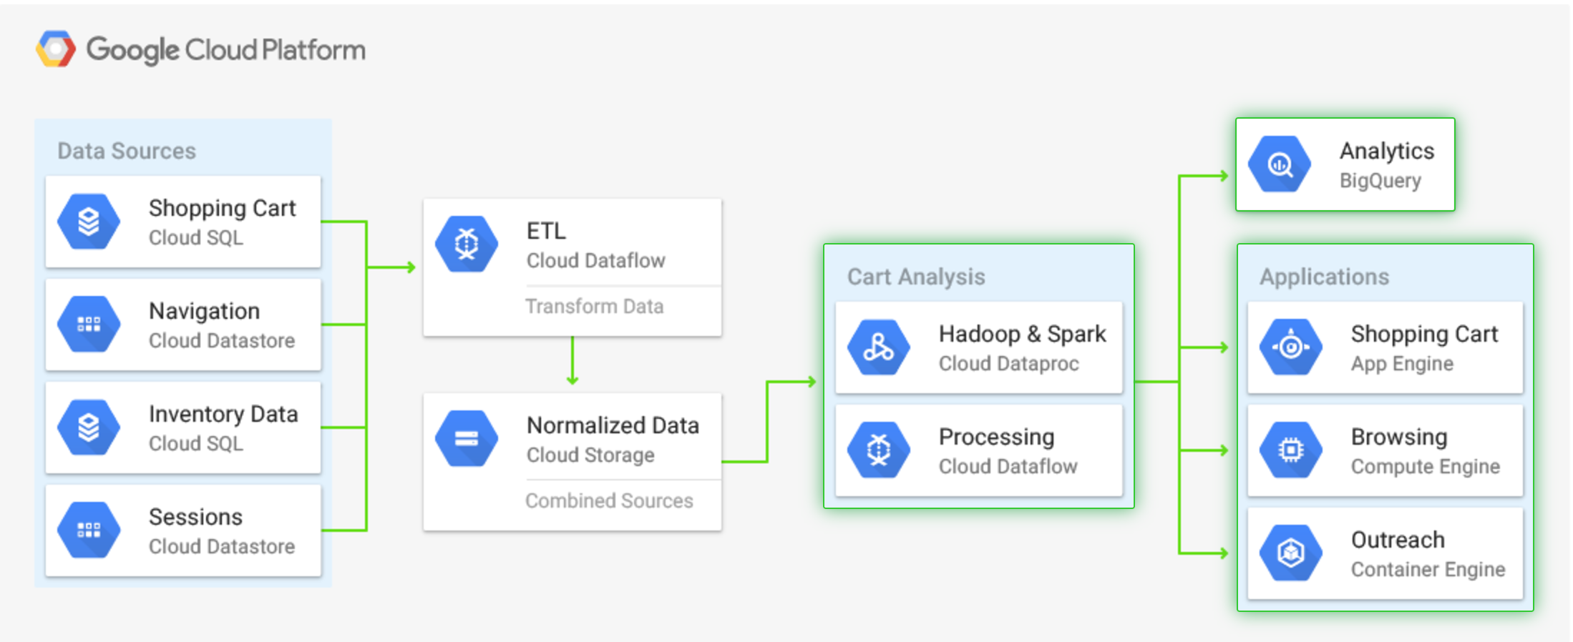
Shopping Cart Analysis
http://gcp.solutions/diagram/Shopping%20Cart%20Analysis

Slide 40
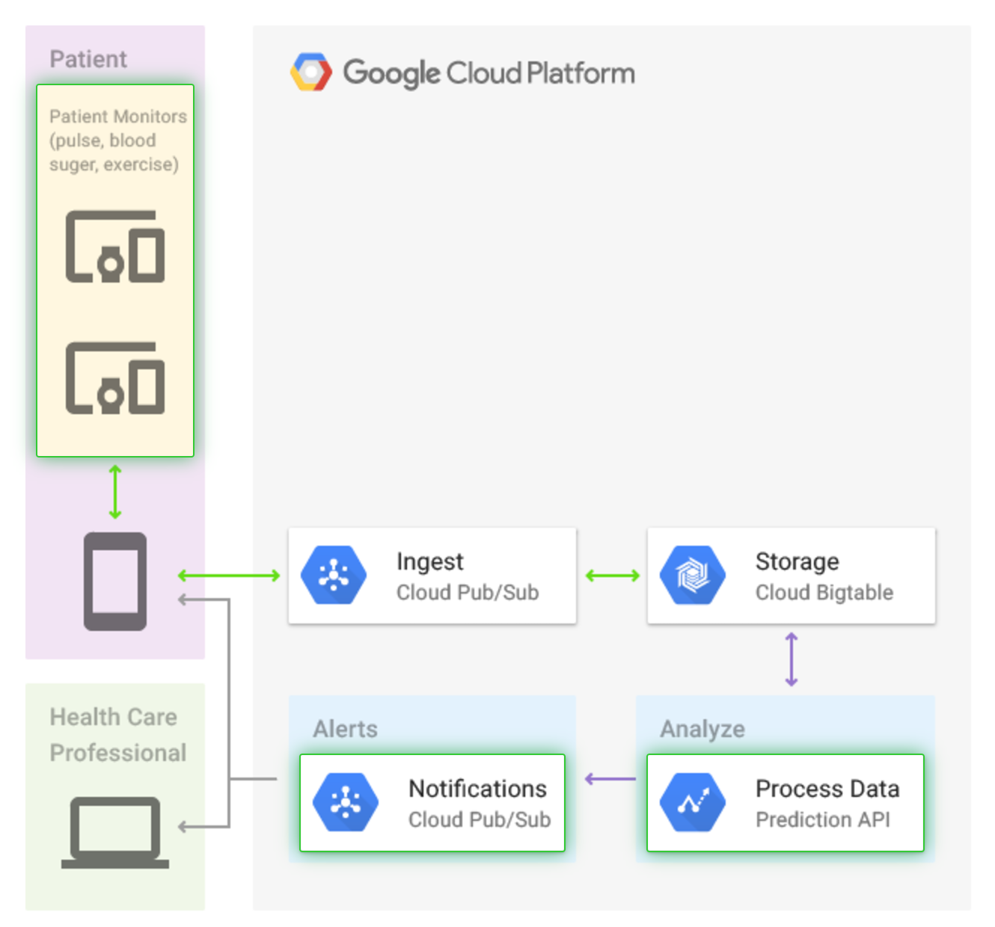
Patient Monitoring
http://gcp.solutions/diagram/Patient%20Monitoring

Slide 41
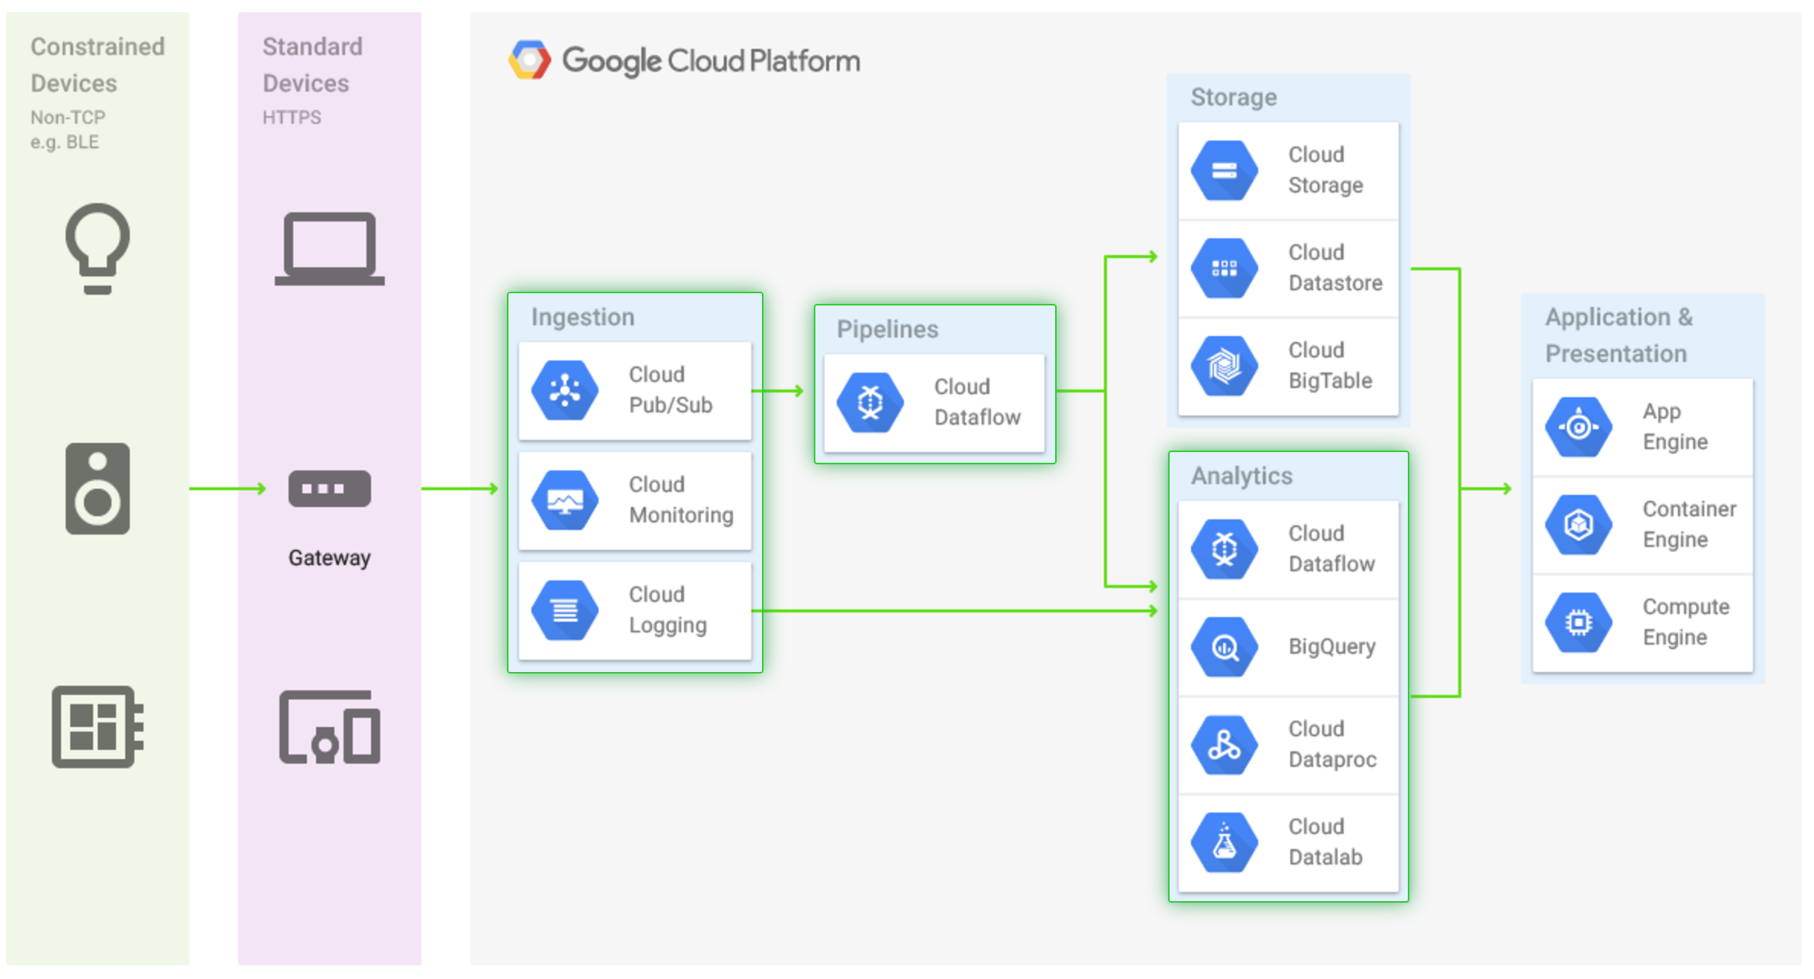
Sensor Stream Ingest and Processing
http://gcp.solutions/diagram/Sensor%20stream%20ingest%20and%20processing

Slide 42
Chapter Concepts
Storage Overview
GCP Storage Options
Architecting Data Processing Solutions
Exam Prep

Slide 43
Do Now: Practice Quiz
Take this practice quiz

Slide 44
Google Cloud Certification Workshop—Data Engineer
Chapter 3:
Storing Binary Data

Slide 45
Chapter Objectives
In this chapter, we will learn how to:
Optimize storage cost and efficiency using Google Cloud Storage
Add storage to virtual machines using persistent disks
Backup disks using snapshots

Slide 46
Chapter Concepts
Google Cloud Storage
Persistent Disks
Exam Prep

Slide 47
Google Cloud Storage
Things to know:
Binary storage for any type of object
Objects are stored in buckets
Buckets must have names that are unique in all the world
There are a number of different storage classes
When creating a bucket, a default storage class is specified, but not all objects in a bucket must share the same storage class
Changing a bucket’s storage class does not affect existing objects
There is no limit to the number of objects that can be stored in a bucket
The maximum size of a single object is 5TB

Slide 48
Storage Classes
Multi-regional storage copies the files across multiple data centers in a geographic area
Choose United States, Europe, or Asia
Regional storage copies data in multiple zones within a single data center
Nearline and Coldline storage are cheaper per GB, but there is a cost to access the data and a minimum storage charge per object

Slide 49
Do Now: Understanding Storage Classes
Fill in the table below; the information can be found at: https://cloud.google.com/storage/docs/storage-classes
 | Multi-Regional | Regional | Nearline | Coldline
Cost/GB/Month
Availability
Durability
Is there a cost to access files?
Minimum storage duration

Slide 50
Choosing Storage Classes
Choose storage class based on the use case for the data:
Is the data accessed by users all over the world?
Is the data accessed by machines all in the same data center?
Is the data accessed frequently?
What is the data used for? (i.e., web content, backup, archive, disaster recovery, etc.)

Slide 51
Do Now: Matching Storage Class to Use Case
Draw an arrow to select the best storage class for each use case
Storing CSV files for analysis using a Hadoop cluster running in Google Cloud Dataproc
Multi-Regional
Archiving old emails to conform to a regulatory requirement
Storing static web files (.pdf, .jpg, .css, .js, etc.) for distribution all over the world
Regional
Storing data files that will be used for training in a machine learning project
Nearline
Storing a huge number of photos that will be made available via a website
Coldline
Storing snapshots of virtual machines in another region so they can be started if the main region is down

Slide 52
Bucket Features
Object metadata
Encryption by default
Versioning
Change notifications and lifecycle management
Simple static website hosting

Slide 53
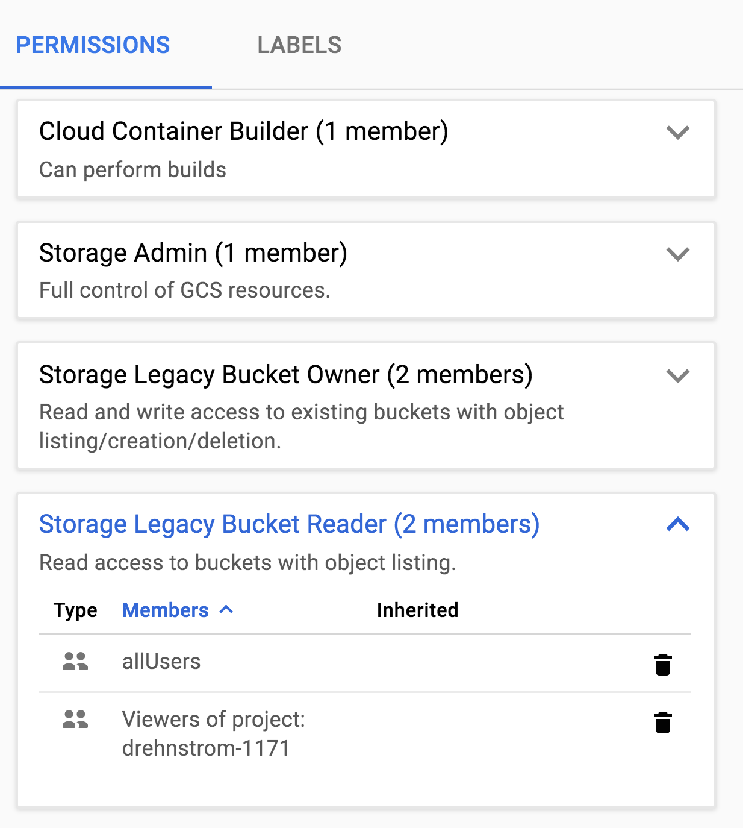
Bucket Security
Permissions can be added to control access to buckets and objects
Use IAM users and groups

Slide 54
Delivering Static Content Worldwide
Objects that are public include a public link
Give allUsers read access
Link in the form of:
https://storage.googleapis.com/{bucket}/{filename}
Upload all static files to a bucket (.css, .js, .html, .jpb, .png, etc.)
Refer to these objects from dynamic web pages
Very scalable and inexpensive
No administration
Use buckets to host web applications written with Javascript frameworks
Angular, React, etc.

Slide 55
Mapping a Bucket to a Domain
Give a bucket a name includes a domain you own
Must prove you own the domain
Example bucket: si.drehnstrom.com
Add a CNAME record that points to c.storage.googleapis.com
Example: go to the link: http://si.drehnstrom.com

Slide 56
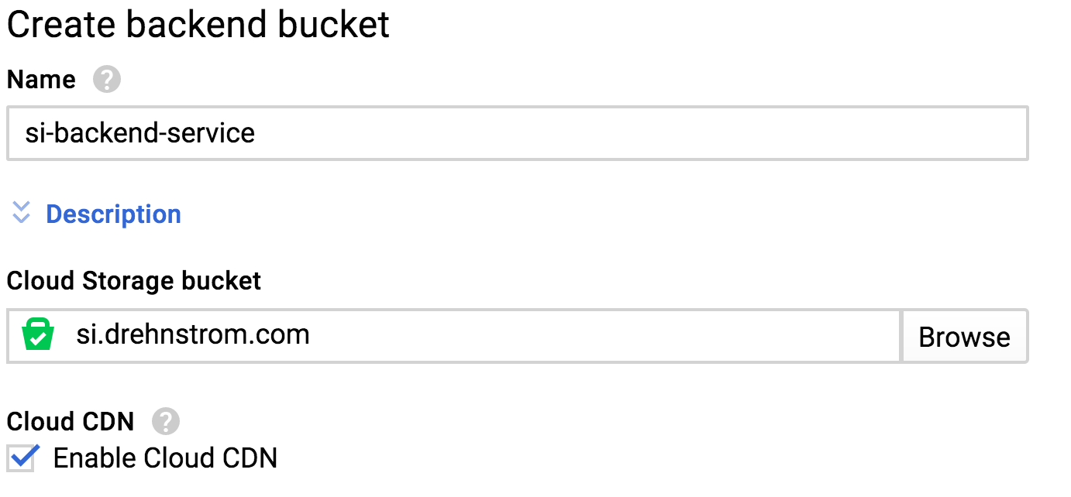
Google CDN (Content Delivery Network)
CDN copies data from a bucket and caches it all over the world
Enabled when creating a load balancer’s back end
Just check the box to enable it
Content automatically delivered from a location close to the user
Map your domain to the load balancer IP address

Slide 57
Do Now: CDN
When delivering web content, you are charged for network egress
Compare the costs of delivering content from a bucket vs. the CDN
https://cloud.google.com/storage/pricing#network-pricing
https://cloud.google.com/cdn/pricing
Which is cheaper?

Slide 58
Exercise: Google Cloud Storage
In this exercise, you will deploy a website using Google Cloud Storage
Google Cloud Storage

Slide 59
Chapter Concepts
Google Cloud Storage
Persistent Disks
Exam Prep

Slide 60
Persistent Disks
Things to know:
Virtual hard drives that can be attached to virtual machines
Three types of disks (Standard, SSD, Local SSD)
Size from 10GB to 64TB
Large drives have greater IOPs and throughput
Must be in the same zone as the virtual machine they are attached to
Local SSDs are directly attached to the same hardware as the VM

Slide 61
Do Now: Persistent Disk Pricing
Go to the following URL and compare the price of persistent disks and storage
https://cloud.google.com/compute/docs/disks/

Slide 62
Snapshots
Things to know:
Snapshots are copies of disks
Stored in Cloud Storage
Multiple snapshots of the same disk only save incremental changes
When deleting earlier snapshots, all information required to rebuild the disk is retained
Snapshots can be used when creating disks
Useful for moving disks to other zones or making disks larger

Slide 63
Prefer Cloud Storage over Persistent Disks
Cloud Storage is less expensive per GB
With Cloud Storage, you pay for what you use; with Disks you pay for what you allocate
Using Cloud Storage separates compute from storage
Allows virtual machines to be more disposable
Makes autoscaling and maintenance easier

Slide 64
Exercise: Disks and Snapshots
In this exercise, you will create a disk, attach it to a virtual machine, and backup the disk using a snapshot
Disks and Snapshots

Slide 65
Chapter Concepts
Google Cloud Storage
Persistent Disks
Exam Prep

Slide 66
Do Now: Practice Quiz
Take this practice quiz

Slide 67
Links
Google Cloud Storage
Persistent Disks
Cloud CDN

Slide 68
Google Cloud Certification Workshop—Data Engineer
Chapter 4:
Storing Relational Data

Slide 69
Chapter Objectives
In this chapter, we will learn how to:
Store relational data using Google Cloud SQL
Create massively scalable relational databases using Spanner

Slide 70
Chapter Concepts
Understanding Relational Storage
Cloud SQL
Spanner
Exam Prep

Slide 71
Benefits of Relational Databases
Strongly type schema that enforces data integrity
Relationships ensure no orphan records between parent-child tables
Flexible indexing for fast, efficient retrieval
Strongly consistency, ACID transactions
Familiar to many database admins and programmers
Standard SQL language works across many database implementations

Slide 72
Modeling Relational Data
Tables contain fields, indexes, and constraints
Primary key ensures each row in a table should be unique
Relationships are constraints that ensure a parent row cannot be deleted if there are child rows in another table
Customers
ID: int FirstName: string LastName: string ...
Orders
ID: int CustomerID: int OrderDate: date ...
OrderDetails
ID: int OrderID: int Qty: int Description: string ...
1
∞
1
∞

Slide 73
Chapter Concepts
Understanding Relational Storage
Cloud SQL
Spanner
Exam Prep

Slide 74
Google Cloud SQL
Things to know:
Manage relational database running in GCP
Supports MySQL and PostgreSQL
Database size from 10GB to 10TB
Automatic maintenance and backups
Create failover replica for high availability
Firewall blocks all traffic outside a project by default
Authorized networks to provide access as needed

Slide 75
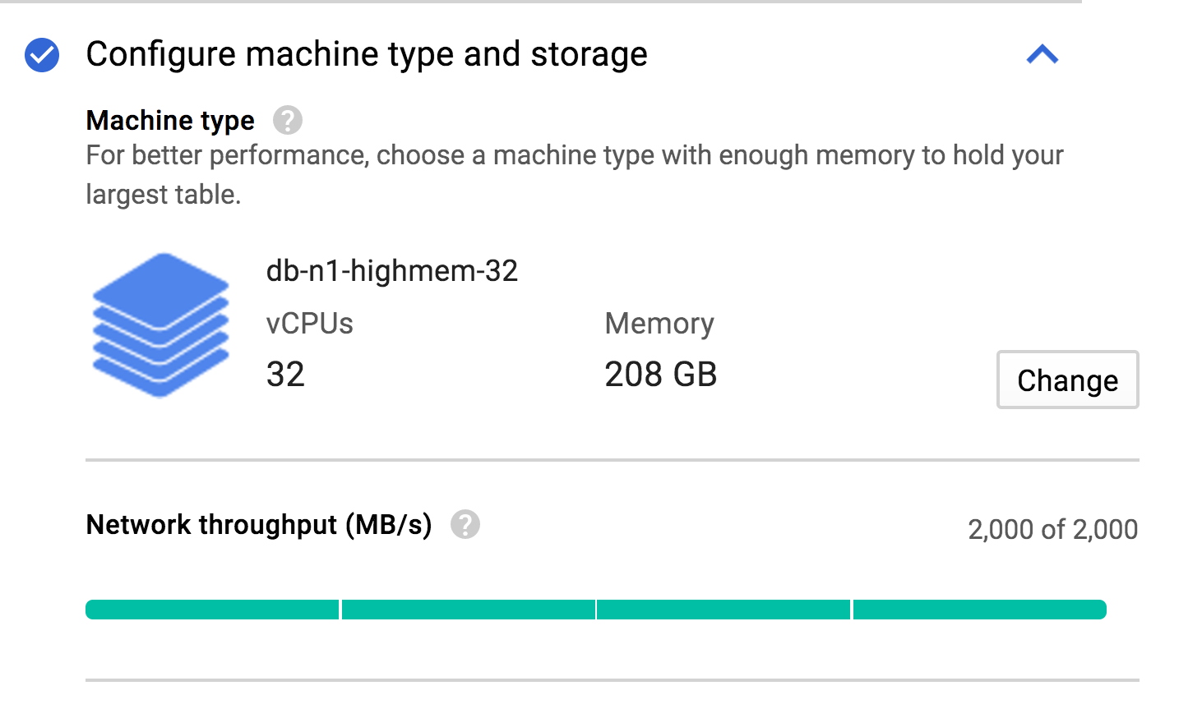
Scaling Cloud SQL Databases
Scale up (vertical scaling)
Machine type determines capacity
Add vCPUs and memory to support more throughput
Can also create a read replica

Slide 76
Demo: Creating a Cloud SQL Database
Your instructor will demo creating a Cloud SQL database

Slide 77
Exercise: Cloud SQL Quickstart
In this exercise, you will get started using Google Cloud SQL
Cloud SQL Quickstart

Slide 78
Chapter Concepts
Understanding Relational Storage
Cloud SQL
Spanner
Exam Prep

Slide 79
Google Cloud Spanner
Things to know:
Completely managed relational database
No need to worry about updates or maintenance
Scales globally across regions
Number of nodes determines capacity
Designed for extremely large relational databases

Slide 80
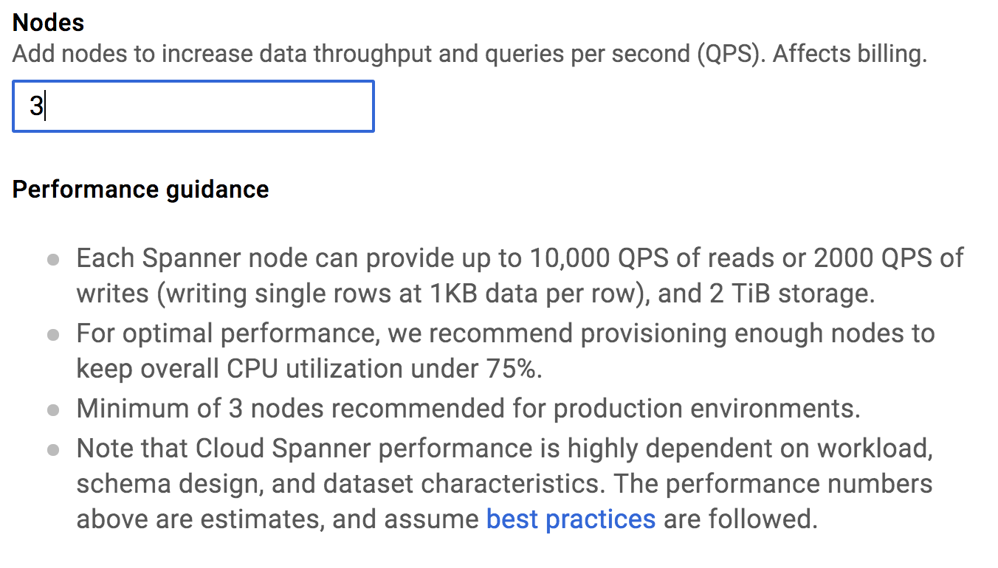
Scaling Spanner Database
Scale out (horizontal scaling)
Add nodes to support more users

Slide 81
What Makes Spanner Special?
Spanner can scale horizontally by adding nodes while still maintaining strongly consistent ACID transactions
Uses atomic clocks attached to the servers that run Spanner
Spanner is unique in the world and has no competitor
Spanner is proven, having been used internally at Google for years

Slide 82
Do Now: Comparing Cloud SQL and Spanner
Visit the following URLs and fill in the table below
https://cloud.google.com/sql/docs/
https://cloud.google.com/spanner/docs/
 | Cloud SQL | Spanner
Cost of compute
Cost of storage

Slide 83
Exercise: Spanner Quickstart
In this exercise, you will get started using Google Cloud Spanner
Google Cloud Spanner Quickstart

Slide 84
Chapter Concepts
Understanding Relational Storage
Cloud SQL
Spanner
Exam Prep

Slide 85
Do Now: Practice Quiz
Take this practice quiz

Slide 86
Links
Cloud SQL
Spanner

Slide 87
Google Cloud Certification Workshop—Data Engineer
Chapter 5:
Managed NoSQL Solutions

Slide 88
Chapter Objectives
In this chapter, we will learn how to:
Consider the advantages and disadvantages of NoSQL storage
Leverage Google Cloud Datastore for a NoSQL document store
Store massive amounts of data using Google BigTable

Slide 89
Chapter Concepts
Understanding NoSQL Storage
Cloud Datastore
BigTable
Exam Prep

Slide 90
NoSQL Storage
Structured storage like relational databases but with key differences
Tend to be schemaless
May or may not support transactions
Varying support for SQL
Easier to use, especially when storing data in object-oriented systems
Often support hierarchical and nested data
NoSQL systems tend to be highly scalable and can scale horizontally
Tools are often less mature for NoSQL than for relational databases
Ad-hoc reporting sometimes harder
Query syntax tends to be different

Slide 91
Types of NoSQL Database
Key-value stores
Data is stored in key-value pairs
Examples include Redis and SimpleDB
Document stores
Data is stored in some standard format like XML or JSON
Nested and hierarchical data can be stored together
MongoDB, CouchDB, and DynamoDB are examples
Wide-column stores
Key identifies a row in a table
Columns can be different within each row
Cassandra and HBase are examples

Slide 92
Do Now: Comparing NoSQL to Relational
Fill in the table below:
Advantages of NoSQL Databases | Advantages of Relational Databases

Slide 93
Chapter Concepts
Understanding NoSQL Storage
Cloud Datastore
BigTable
Exam Prep

Slide 94
Google Cloud Datastore
Things to know:
Completely managed document store
No administration, no maintenance, nothing to provision or set up
1GB per month free tier
Indexes created for every property by default
Secondary indexes and composite indexes are supported
Supports ACID transactions
Schemaless
For pricing info see: https://cloud.google.com/datastore/pricing

Slide 95
Relational vs. Datastore Terminology
Relational | Datastore
Tables | Kinds
Records | Entities
Fields | Properties
Primary Key | Key
Relationship | Entity Group
Primary-Foreign Keys | Ancestor Paths

Slide 96
Modeling Datastore Entities
Datastore entities have one or more properties
Can be scalar values like strings, dates, numbers, bools, blobs, etc.
Properties can be arrays
Properties can be embedded entities
Properties can be indexed or not
Can create composite indexes
Different entities of the same kind can have different properties

Slide 97
Exercise: Datastore Quickstart
In this exercise, you will get started using Google Cloud Datastore
Google Cloud Datastore Quickstart

Slide 98
Chapter Concepts
Understanding NoSQL Storage
Cloud Datastore
BigTable
Exam Prep

Slide 99
Google BigTable
Things to know:
Fully-managed, wide-column NoSQL datastore similar to Cassandra or HBase
Designed for scalability—add compute nodes to meet demand
Compute separate from storage
Allows nodes to be added or removed to meet demand without affecting the data
Secure
Data encrypted by default
Use IAM to assign permissions
Uses same API as HBase
Allows on-premises HBase applications to be easily migrated

Slide 100
BigTable Schemas
Store data in tables
Tables have rows
Each row has a key
Rows have columns
Columns can be grouped in column families
Store all data about an entity in a single row
There is no penalty for sparse columns (columns with no data)
Updates to a single row are in implicit transactions
Transactions across multiple rows are not supported

Slide 101
BigTable Row Keys
BigTable does not support indexes other than on the row key
Rows are stored in row-key order
When selecting data, you select it by row key, key prefix, or range of keys
Choose keys based on how you would most likely select the data
Can embed multiple values in the key
For more information on selecting row keys see: https://cloud.google.com/bigtable/docs/schema-design#row-keys

Slide 102
Do Now: Comparing Storage Prices
Using the Price Calculator, estimate the cost of running a 10TB database using Cloud SQL, Spanner, Datastore, and BigTable
Do your best to estimate the values for each product
Use the documentation to help with your estimates
Notes:
https://cloud.google.com/products/calculator/#id=a0518a39-ae29-4bd6-868b-162dc3e6fe64

Slide 103
Chapter Concepts
Understanding NoSQL Storage
Cloud Datastore
BigTable
Exam Prep

Slide 104
Do Now: Practice Quiz
Take this practice quiz

Slide 105
Links
Datastore
BigTable

Slide 106
Google Cloud Certification Workshop—Data Engineer
Homework

Slide 107
Links
Google Cloud Storage
Persistent Disks
Cloud CDN
Cloud SQL
Spanner
Datastore
BigTable

Slide 108
Videos
Google Cloud Platform Storage Versioning Demo
Google Cloud Platform Enabling CORS
Google Cloud Platform Cloud SQL Demo
Google Cloud Platform Datastore Demo
Google Cloud Platform Bulk Loading to Datastore Demo
Choosing your storage and database on Google Cloud Platform
Cloud Spanner 101

Slide 109
Tutorials
Google Cloud Storage
Disks and Snapshots
Cloud SQL Quickstart
Cloud Spanner Quickstart
Datastore Quickstart

Slide 110
Google Cloud Certification Workshop—Data Engineer
Chapter 6:
Big Data Processing and Analytics

Slide 111
Chapter Objectives
In this chapter, we will learn how to:
Process big data using Google Cloud Platform services
Run Hadoop and Spark Jobs in GCP using Google Cloud Dataproc
Leverage BigQuery for NoOps data warehousing and analysis
Write BigQuery queries

Slide 112
Chapter Concepts
Big Data Processing Overview
Google Cloud Dataproc
BigQuery
Choosing Big Data Strategies
Exam Prep

Slide 113
Google’s Original Mission Statement
“To organize the world's information and make it universally accessible and useful.”

Slide 114
Achieving the Mission
Traditional technologies were not capable of collecting and processing the amount of data Google was accumulating
For Google to achieve its mission, it had to invent new technologies
Needed a massively distributed file system
Drives are slow, so connect many together to reduce the bottleneck
Needed a way of getting huge jobs done quickly

Slide 115
The 3 V’s of Big Data
Volume – there is a lot of data
Need many drives to store the data
Velocity – if there is a lot, then you must be collecting it at a fast rate
Need to be able to write to drives very quickly
Need to be able to get the data back very quickly
Variety – the data is coming for many different sources
Web pages
Text files
Logs
PDFs
Databases
Etc.

Slide 116
Google vs. 1: GFS and MapReduce
Google created a distributed file system named GFS (Google File System)
Allowed data to be read and written quickly
Google created the MapReduce algorithm for splitting a job across many machines to get it done quicker
GFS and MapReduce were later implemented at Yahoo based on a paper released by Google
This became HDFS and Hadoop
Hadoop project was later given to the Apache Group to manage

Slide 117
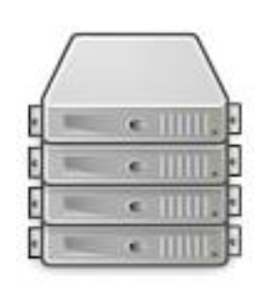
GFS and MapReduce Illustrated
Master
Workers
Network
Storage

Slide 118
Google vs. 2: Colossus and Dremel
Colossus replaced GFS as the distributed file system
We know Colossus as Google Cloud Storage
Dremel replaced MapReduce for distributed processing
Similar to Hive, Spark SQL, or Presto
We know Dremel as BigQuery

Slide 119
Chapter Concepts
Big Data Processing Overview
Google Cloud Dataproc
BigQuery
Choosing Big Data Strategies
Exam Prep

Slide 120
Dataproc
Service for easily creating Hadoop/Spark clusters
Simple configuration
Clusters created in just a couple minutes
Easy to submit jobs
Dataproc clusters supports all common Hadoop and Spark frameworks
Easy to migrate on-premises workloads into the cloud
HDF Cluster automatically created for storage

Slide 121




Dataproc Supports Hadoop Ecosystem

Slide 122
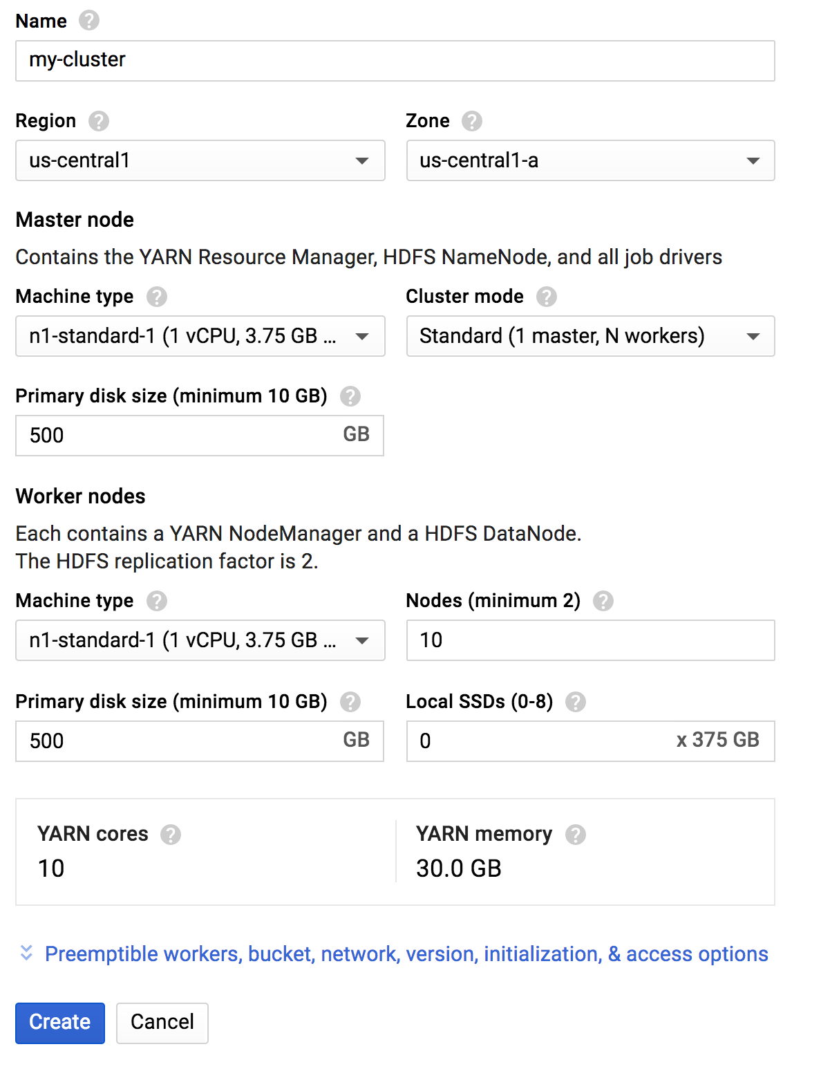
Creating a Dataproc Cluster
Select a zone close to your data
Configure the Master
Configure the Workers
The disks are used in the HDFS cluster

Slide 123
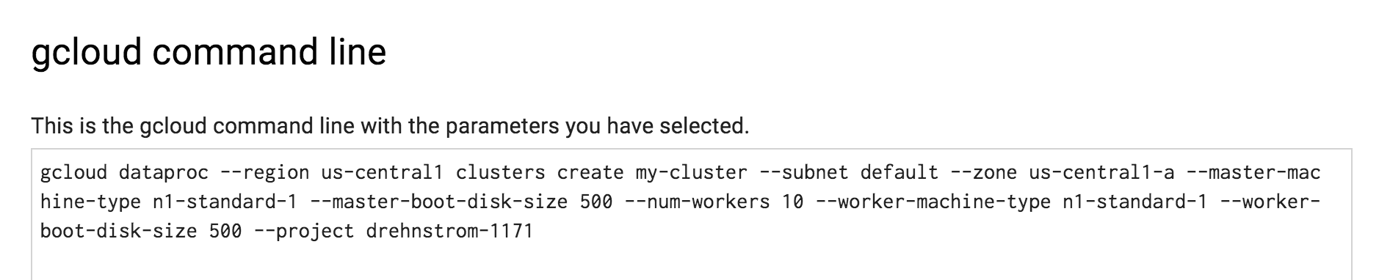
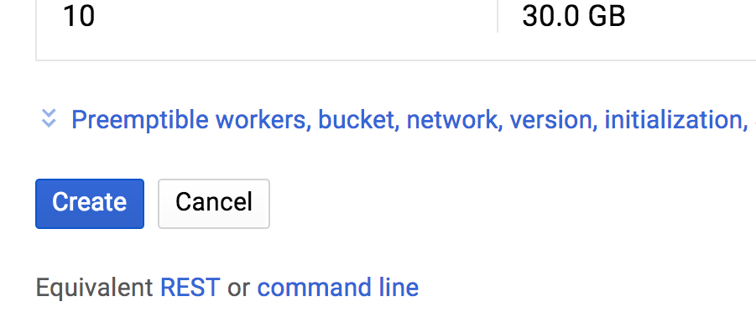
Scripting Dataproc Cluster Creation
Click the command line link on the configuration page
Opens another window with the command pre-built
Use this command for creating a script to automate cluster creation

Slide 124
Separate Compute and Storage
Dataproc creates an HDFS cluster, but don’t use it for long-lived storage
Store the data to analyze in Google Cloud Storage
Cloud Storage is cheaper (HDFS cluster created on Persistent Disks)
Only pay for what you use, not for what you allocate
Separating storage and compute allows the cluster to be disposable
Delete the cluster as soon as possible
Only pay for it while it is working
Can recreate the cluster in a couple minutes

Slide 125
Exercises: Dataproc Clusters
In this exercise, you will create a Dataproc cluster and experiment with managing the cluster and running Hadoop and Spark jobs
Creating Dataproc Clusters
In this exercise, you see how to run Hive and Spark jobs on Dataproc clusters and also how to scale clusters while they are running using preemptible workers
GCP Dataproc: Running Hive and Spark Jobs

Slide 126
Chapter Concepts
Big Data Processing Overview
Google Cloud Dataproc
BigQuery
Choosing Big Data Strategies
Exam Prep

Slide 127
BigQuery
BigQuery consists of two main services
Data warehousing
Data analytics

Slide 128
BigQuery Data Warehousing
Things to know:
BigQuery has its own storage system
Most efficient storage when running BigQuery queries
Projects contain datasets, which contain tables
There is no limit to the number of tables in a dataset
There is no limit to the number of rows in a table
Each field in a table is stored separately
Makes querying more efficient because only fields in a query are read
All data is encrypted by default
All data is compressed for faster processing

Slide 129
BigQuery Schemas
Tables must have a schema which defines field names and data types
Schemas support nested, hierarchical data
Schemas support repeated fields
For example, an Orders table can have a field called Details which is an array of records which provides details about each order
Repeated, nested fields allow querying parent-child relationships without needing to join two tables
Joins are expensive in BigQuery since there are no indexes

Slide 130
BigQuery Storage Cost
Storage cost is:
2 cents per GB per month for the first 3 months
After 3 months, data storage is reduced to 1 cent per GB per month
Quiz: If you put 10TB of data in BigQuery today and left it there for a year, how much would it cost?

Slide 131
BigQuery Data Analytics
Things to know:
Use standard ANSI SQL 2011 for building Select queries
Can write user-defined functions to manipulate data in SQL or JavaScript
Can query from a number of data sources:
BigQuery Storage
Google Cloud Storage
Google BigTable
Google Sheets
Completely NoOps
No need to provision anything
No need to tune queries

Slide 132
BigQuery Analysis Cost
Queries are charged one of two ways: on-demand and flat-rate
On demand at $5/TB of data processed with 1TB free per month
With flat-rate pricing, you pre-purchase BigQuery capacity
Capacity is measured in “slots”, a unit of processing in BigQuery
Run as many queries as you can, but you will never go over your purchased slots

Slide 133
Writing BigQuery Queries
There are two dialects of BigQuery SQL, Legacy and Standard
Legacy was the original, replaced in 2016
Standard SQL is ANSI 2011 SQL compliant
Very minor differences exist due to the platform
Standard SQL includes data manipulation language (DML) statements
INSERT, UPDATE, DELETE
Strict quotas apply to DML statements

Slide 134
Standard SQL Examples
Comment instructs BigQuery to use Standard not Legacy SQL
#standardsql SELECT city, count(city) as city_count FROM `drehnstrom-1171.sales_dataset.stores` GROUP BY city ORDER BY city_count DESC LIMIT 1000
Back ticks, not quotes, surround the table name
To refer to a table, the syntax is:
`project-id.dataset.table`
#standardsql SELECT store, name FROM `drehnstrom-1171.sales_dataset.stores` WHERE city = 'DES MOINES' LIMIT 1000

Slide 135
Standard SQL JOIN Example
#standardsql SELECT name, sum(total) as sales FROM `drehnstrom-1171.sales_dataset.stores` as stores JOIN `drehnstrom-1171.sales_dataset.sales` as sales ON stores.store = sales.store GROUP BY name LIMIT 10

Slide 136
Standard SQL WITH Example
#standardsql with total_sales as (SELECT name, sum(total) as sales FROM `drehnstrom-1171.sales_dataset.stores` as stores JOIN `drehnstrom-1171.sales_dataset.sales` as sales ON stores.store = sales.store GROUP BY name) SELECT name, CAST(ROUND(sales, 0) as STRING) from total_sales WHERE sales > 10000 ORDER BY sales DESC

Slide 137
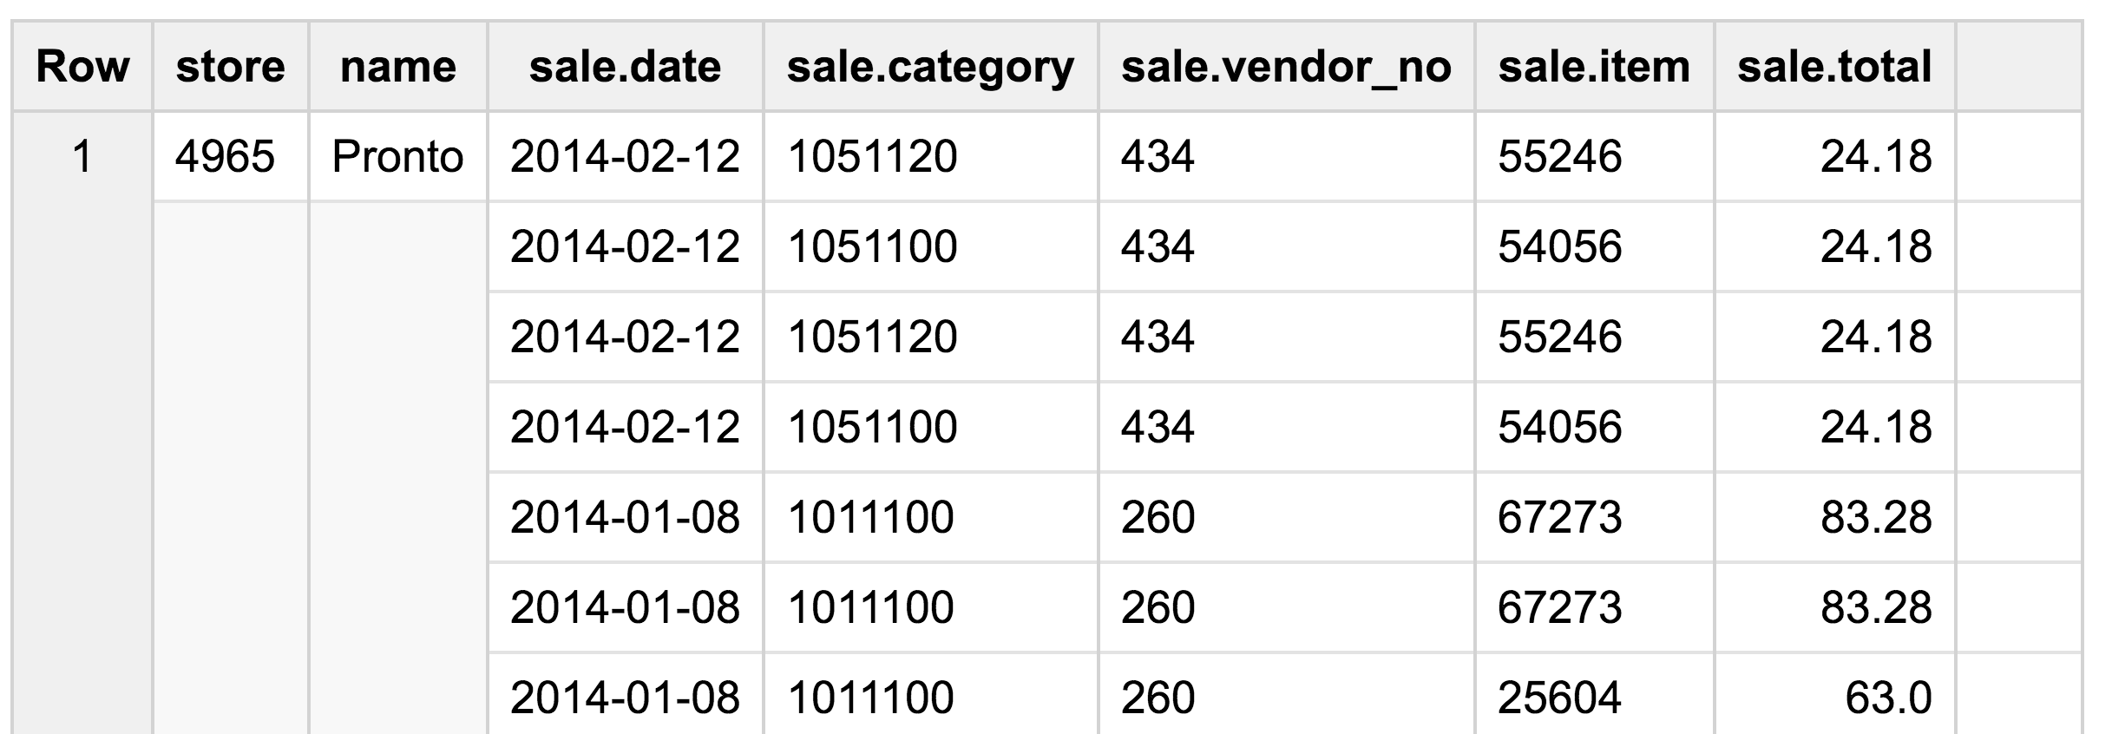
Denormalization Example
#standardsql SELECT stores.store, name, ARRAY_AGG( STRUCT(sales.date, sales.category, vendor_no, item,sales.total)) as sale FROM `drehnstrom-1171.sales_dataset.sales` as sales JOIN `drehnstrom-1171.sales_dataset.stores` as stores ON sales.store = stores.store GROUP BY stores.store, name
STRUCT function creates a composite field. ARRAY_AGG function creates an array.
Notes:
#standardsql
SELECT stores.store, name,
ARRAY_AGG(
STRUCT(sales.date, sales.category,
vendor_no, item,sales.total)) as sale
FROM
`drehnstrom-1171.sales_dataset.sales` as sales
JOIN
`drehnstrom-1171.sales_dataset.stores` as stores
ON
sales.store = stores.store
GROUP BY stores.store, name

Slide 138
Querying Denormalized Data
#standardsql
SELECT name, ARRAY_LENGTH(sale) as count_sales
FROM `drehnstrom-1171.sales_dataset.store_sales_denormalized`
ORDER BY count_sales DESC
LIMIT 10
UNNEST flattens the array of objects so they are queryable
#standardsql SELECT name, (SELECT sum(total) from UNNEST(sale)) as total_sales FROM `drehnstrom-1171.sales_dataset.store_sales_denormalized` ORDER BY total_sales DESC LIMIT 10

Slide 139
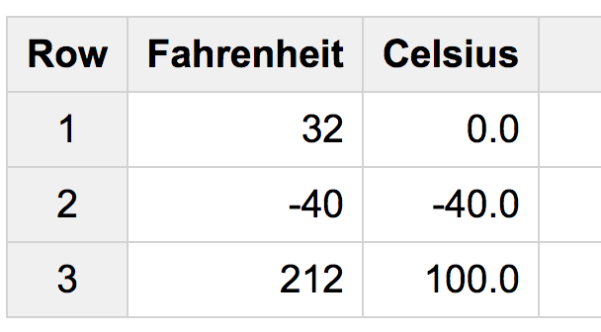
User-Defined Function Example
CREATE TEMPORARY FUNCTION to_celsius(temp FLOAT64)
RETURNS FLOAT64
LANGUAGE js AS """
return (temp - 32.0) * 5.0 / 9.0;
""";
WITH temps AS
(SELECT 32 AS Fahrenheit
UNION ALL
SELECT -40 AS Fahrenheit
UNION ALL
SELECT 212 as Fahrenheit)
SELECT Fahrenheit, to_celsius(Fahrenheit) as Celsius
FROM temps;
Can use JavaScript or SQL when writing a UDF

Slide 140
Do Now: Using BigQuery
Log into GCP Management Console
From the Products and Services menu, choose BigQuery
Run each of the queries from the last few slides

Slide 141
BigQuery Performance Tips
Denormalize parent-child relationships
Store child records as repeated records with the parent row
Allows querying related data without a join
Queries that were already run are cached
Data returned from the cache is free
For very large tables, create smaller temp tables when possible
Partition tables when data is accumulated on a regular basis
For example, daily logs, daily sales, etc.
Can specify the data range of partitions to query, avoiding a table scan
Don’t group by fields with a very large number of different values
Prefer built-in functions to UDFs if possible

Slide 142
Querying External Data Sources
BigQuery can analyze data directly from:
BigTable
Cloud Storage
Google Drive
Must define a table schema for the external source
Not as efficient as BigQuery native storage
Native storage puts fields in separate tables so queries only have to scan the fields in the query, not the whole table
Useful for ETL and denormalization jobs
Read data from external source, manipulate it, and load it into BigQuery
See: https://cloud.google.com/bigquery/external-data-sources

Slide 143
Exercise: Querying Data with BigQuery
In this exercise, you will upload data into BigQuery and then query that data
Querying Data with BigQuery

Slide 144
Chapter Concepts
Big Data Processing Overview
Google Cloud Dataproc
BigQuery
Choosing Big Data Strategies
Exam Prep

Slide 145
Migrating from On-Premises Hadoop to Dataproc
Can run existing Hadoop and Spark jobs on Dataproc
Use Cloud Storage not HDFS so the Dataproc cluster can be deleted without deleting the data
Make the attached disks small
Move HBase workloads to BigTable to reduce administration
Script creation of Dataproc clusters and jobs
Delete the cluster when the jobs are completed to reduce cost
Machines are billed in 1-minute increments with a 10-minute minimum
Consider using preemptible instances for some of the workers

Slide 146
Migrating a Data Warehouse to BigQuery
Denormalize data for better performance in BigQuery
Traditional data warehouses use a star schema and indexes for efficiency
BigQuery has no indexes, so Joins are costly
Can use Dataflow to denormalize data prior to putting it in BigQuery
Can alternatively leverage BigQuery for denormalization jobs
Write a query that joins tables and creates arrays of structs
Specify a destination table
Partition tables that accumulate data over time

Slide 147
Do Now: Choosing Dataproc or BigQuery
Fill in the table below:
 | Advantages | Disadvantages
Dataproc
BigQuery

Slide 148
Chapter Concepts
Big Data Processing Overview
Google Cloud Dataproc
BigQuery
Choosing Big Data Strategies
Exam Prep

Slide 149
Do Now: Practice Quiz
Take this practice quiz

Slide 150
Links
Dataproc
BigQuery

Slide 151
Google Cloud Certification Workshop—Data Engineer
Chapter 7:
Data Processing Pipelines

Slide 152
Chapter Objectives
In this chapter, we will learn how to:
Examine data processing challenges and architectures
Leverage Google Cloud Dataflow for NoOps processing pipelines
Process real-time, streaming pipelines with Pub/Sub
Simplify data pipelines with Google Cloud Dataprep

Slide 153
Chapter Concepts
Data Processing Architectures
Google Cloud DataFlow
Pub/Sub
Cloud Dataprep
Exam Prep

Slide 154
Data Processing Pipelines
Perform a set of actions in a chain
Data from one or more sources is read into the pipeline
Actions are performed on the data to manipulate or transform it
The manipulated results are sent as output from the pipeline
Actions within a data pipeline can run at the same time (concurrently)
At scale, multiple machines can participate to get the pipeline done faster
MapReduce jobs are examples of pipelines at scale
Multiple nodes read data from disk and perform an initial map step
Data is then organized by key (the shuffle step)
Keyed data is processed separately in parallel (the reduce step)

Slide 155
Batch vs. Streaming Pipelines
Batch data flows process big chunks of data at set intervals
Analyzing daily logs
Importing monthly sales
Periodic data conversions
Streaming data flows process data as it is accumulated
Analyzing traffic to determine the quickest route
What tweets are trending right now
What products are selling today

Slide 156
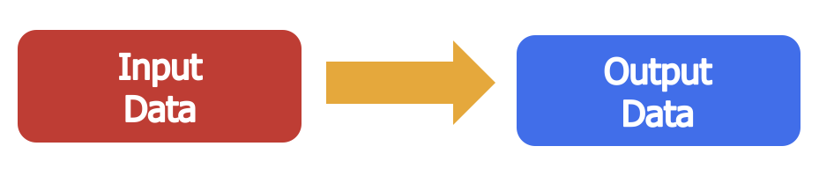
Moving Data
The simplest data flow is simply moving data from one location to another
Hardly a difficult problem unless huge amounts of data are involved

Slide 157
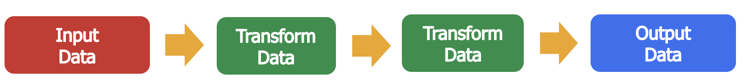
Moving and Transforming Data
Data is moved from one place to another, but altered along the way
More complicated as the amount of data increases and the transformations become more complex
More data and more processing means more time
More machines can participate in the process to get the job done faster
This increases cost and complexity

Slide 158
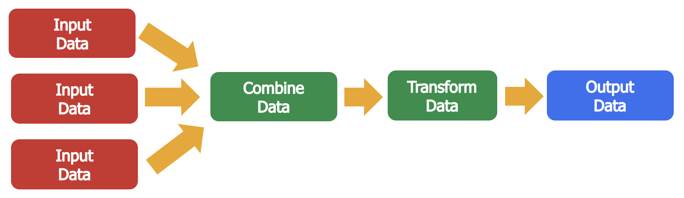
Multiple Inputs
Sometimes a pipeline requires input from multiple data sources
Data from a web log might be combined with sales data from a database

Slide 159
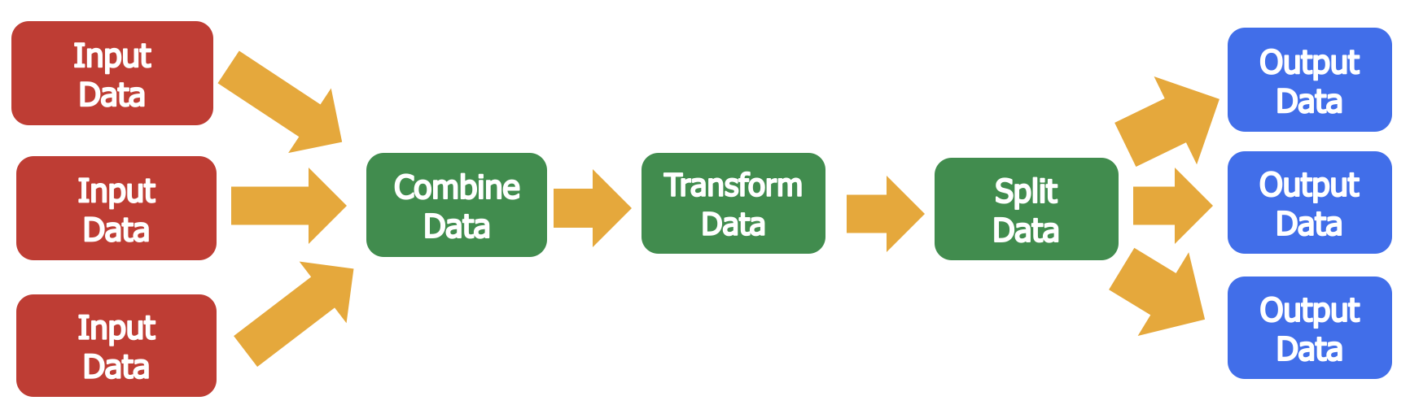
Multiple Outputs
Sometimes a pipeline needs to output the data more than one way
Outputting the same data in multiple, different formats can make data analysis easier and more efficient
Storage is cheap relative to processing power and time

Slide 160
Chapter Concepts
Data Processing Architectures
Google Cloud DataFlow
Pub/Sub
Cloud Dataprep
Exam Prep

Slide 161
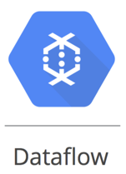
Google Cloud Dataflow
Google Cloud Dataflow consists of two major pieces
A managed service for running data flow pipelines
Apache Beam SDK for making programming of data flows easier

Slide 162
Dataflow Managed Service
Dataflow pulls together a number of GCP services to run data flows
It is the job of the Dataflow service to optimize execution
Cloud Storage is used as a staging area for data flow code
Can also be used for data input and output
BigQuery tables can be used for input and output
BigQuery is frequently the preferred tool to analyze data flow output
Cloud Compute instances are used to execute data flows
The Dataflow service determines how many instances are required
Google’s high-speed network is used to move data around
Pub/Sub is used to provide streaming data flows

Slide 163
Processing Batch and Streaming Pipelines
Dataflow jobs can be used to process both batch and streaming pipelines
BigQuery is frequently where the output is written for later analysis

Slide 164
Demo: Dataflow
Your instructor will demo running a Dataflow job

Slide 165

Apache Beam
Open-source SDK for writing data processing pipelines
Java and Python versions
Runs on any platform, not just Google Cloud Dataflow
Spark clusters, for example
See: https://beam.apache.org/

Slide 166
Java Word Count Example
Pipeline p = Pipeline.create(options); p.apply(TextIO.read().from("gs://apache-beam-samples/shakespeare/*")) .apply("ExtractWords", ParDo.of(new DoFn<String, String>() { @ProcessElement public void processElement(ProcessContext c) { for (String word : c.element().split("[^\\p{L}]+")) { if (!word.isEmpty()) { c.output(word); }}}})) .apply(Count.<String>perElement()) .apply("FormatResults", MapElements.via(new SimpleFunction<KV<String, Long>, String>() { @Override public String apply(KV<String, Long> input) { return input.getKey() + ": " + input.getValue(); }})) .apply(TextIO.write().to("wordcounts")); p.run().waitUntilFinish();

Slide 167
Python Word Count Example
p = beam.Pipeline(options=options)
p | beam.io.ReadFromText('gs://dataflow-samples/shakespeare/kinglear.txt')
| 'ExtractWords' >> beam.FlatMap(lambda x: re.findall(r'[A-Za-z\']+', x))
| beam.combiners.Count.PerElement()
| beam.Map(lambda (word, count): '%s: %s' % (word, count))
| beam.io.WriteToText('gs://my-bucket/counts.txt')
result = p.run()

Slide 168
Exercise: Google Cloud Dataflow
In this exercise, you will run an Apache Beam pipeline using Google Cloud Dataflow
Dataflow Quickstart using Python
Dataflow Quickstart using Java

Slide 169
Chapter Concepts
Data Processing Architectures
Google Cloud DataFlow
Pub/Sub
Cloud Dataprep
Exam Prep

Slide 170

Pub/Sub
Pub/Sub is a fully managed, massively scalable messaging service
It allows messages to be sent between independent applications
Can scale to millions of messages per second
Pub/Sub messages can be sent and received via HTTP(S)
Pub/Sub supports multiple senders and receivers simultaneously
Pub/Sub is a global service
Messages are copied to multiple zones for greater fault tolerance
Uses dedicated resources in every region for fast delivery worldwide
Pub/Sub is secure
All message are encrypted at rest and in transit

Slide 171
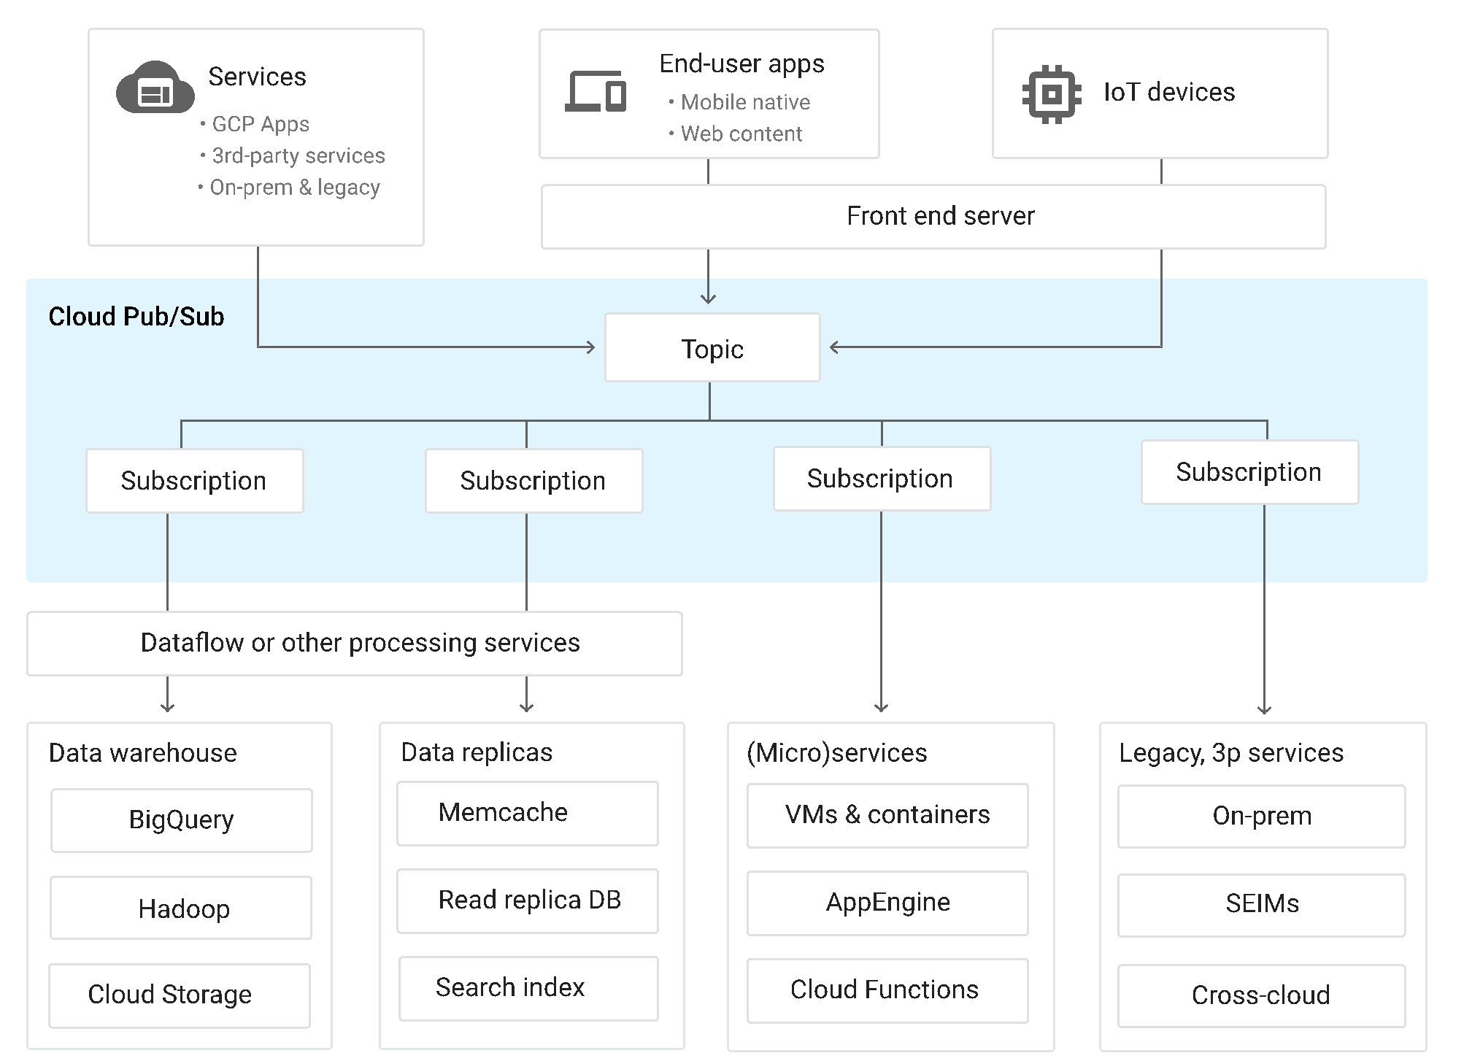
Integrating Pub/Sub with Other Services

Slide 172
Topics and Subscriptions
Messages in Pub/Sub are sent to a Topic
Messages can contain data and attributes
Topics are named endpoints where messages are sent
Topic names are in the form:
projects/<project-id>/topics/<topic-name>
Subscriptions represent a stream of messages within a topic
Topics can contain multiple subscriptions
Each subscription belongs to one topic
Subscribers get messages from subscriptions

Slide 173
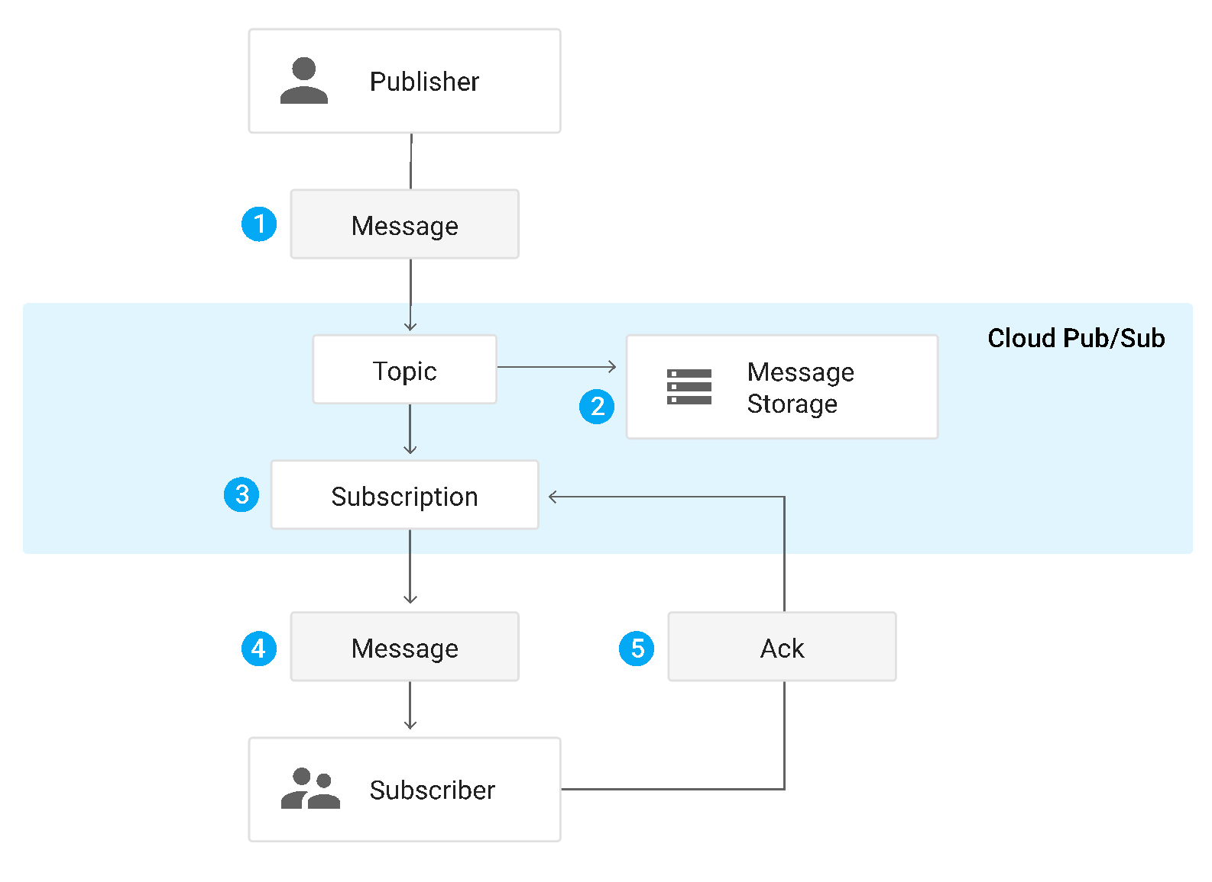
Pub/Sub Message Flow

Slide 174
Subscribers
Subscribers are applications that process Pub/Sub messages
Subscribers get messages from a subscription
Two types of subscriptions, push and pull
Push messages are automatically sent to the subscriber via an endpoint
Acknowledgement of the message is implied by a response code 200
Pull messages must be requested by the subscriber
Subscriber calls the pull() method of the Pub/Sub API
If a message exists, it is sent
Subscriber then calls the acknowledge() method

Slide 175
Push or Pull Subscribers
Push subscribers must be web servers that support HTTPS
Must expose an endpoint to receive the message (a web hook)
Delivery is immediate unless throttled
Can be load balanced
Pull subscribers can be any type of application
Must be able to use the Pub/Sub REST API
App Engine applications are ideal push subscribers
Dataflow jobs are pull subscribers

Slide 176
Using Pub/Sub with Dataflow
Pub/Sub can be utilized within a Dataflow pipeline
PubSub.IO class can read or write to a Pub/Sub topic
Allows for streaming data flows in real time
Pipeline is constantly being sent messages for processing
Can set up windows to process groups of messages by time
When using Pub/Sub, data sets are unbounded
They continue to grow over time
Aggregate operations must be run periodically

Slide 177
Event Time vs. Process Time
Event time is when something actually occurred
The time an order is placed for example
This is when the message is published to Pub/Sub
Process time is when the system observes the event
When the subscriber receives the Pub/Sub message
Obviously, process time is always after event time
Usually, this is a short period of time
Sometimes, a system problem will delay the process time
The difference between event and process times can vary significantly
Event occurs in a mobile application when the user is on an airplane

Slide 178
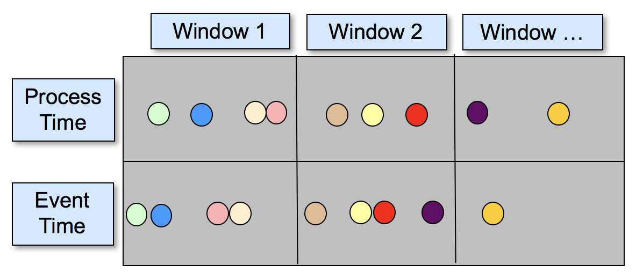
Windowing
Groups data into chunks that aggregate functions are run against
Often based on time, but can also be based on session
Time-based windows can use either event or process time
Sometimes the process time will fall into a different window than the event
What do you notice about the purple data point?

Slide 179
Windowing in Dataflow
Dataflow has built-in support for three types of windows
Shuffles arriving messages into the correct window based on event time
Fixed time windows are the simplest
Each window is given an interval
Sliding time windows have an interval and a period
The interval defines how long a window collects data for
The period defines how often a new window starts
Session windows define windows on areas of concentrated data
Uses a key to combine data into groups
Like sessions in a web application

Slide 180
Demo: Dataflow
Your instructor will demo running a streaming Dataflow

Slide 181
Chapter Concepts
Data Processing Architectures
Google Cloud DataFlow
Pub/Sub
Cloud Dataprep
Exam Prep

Slide 182
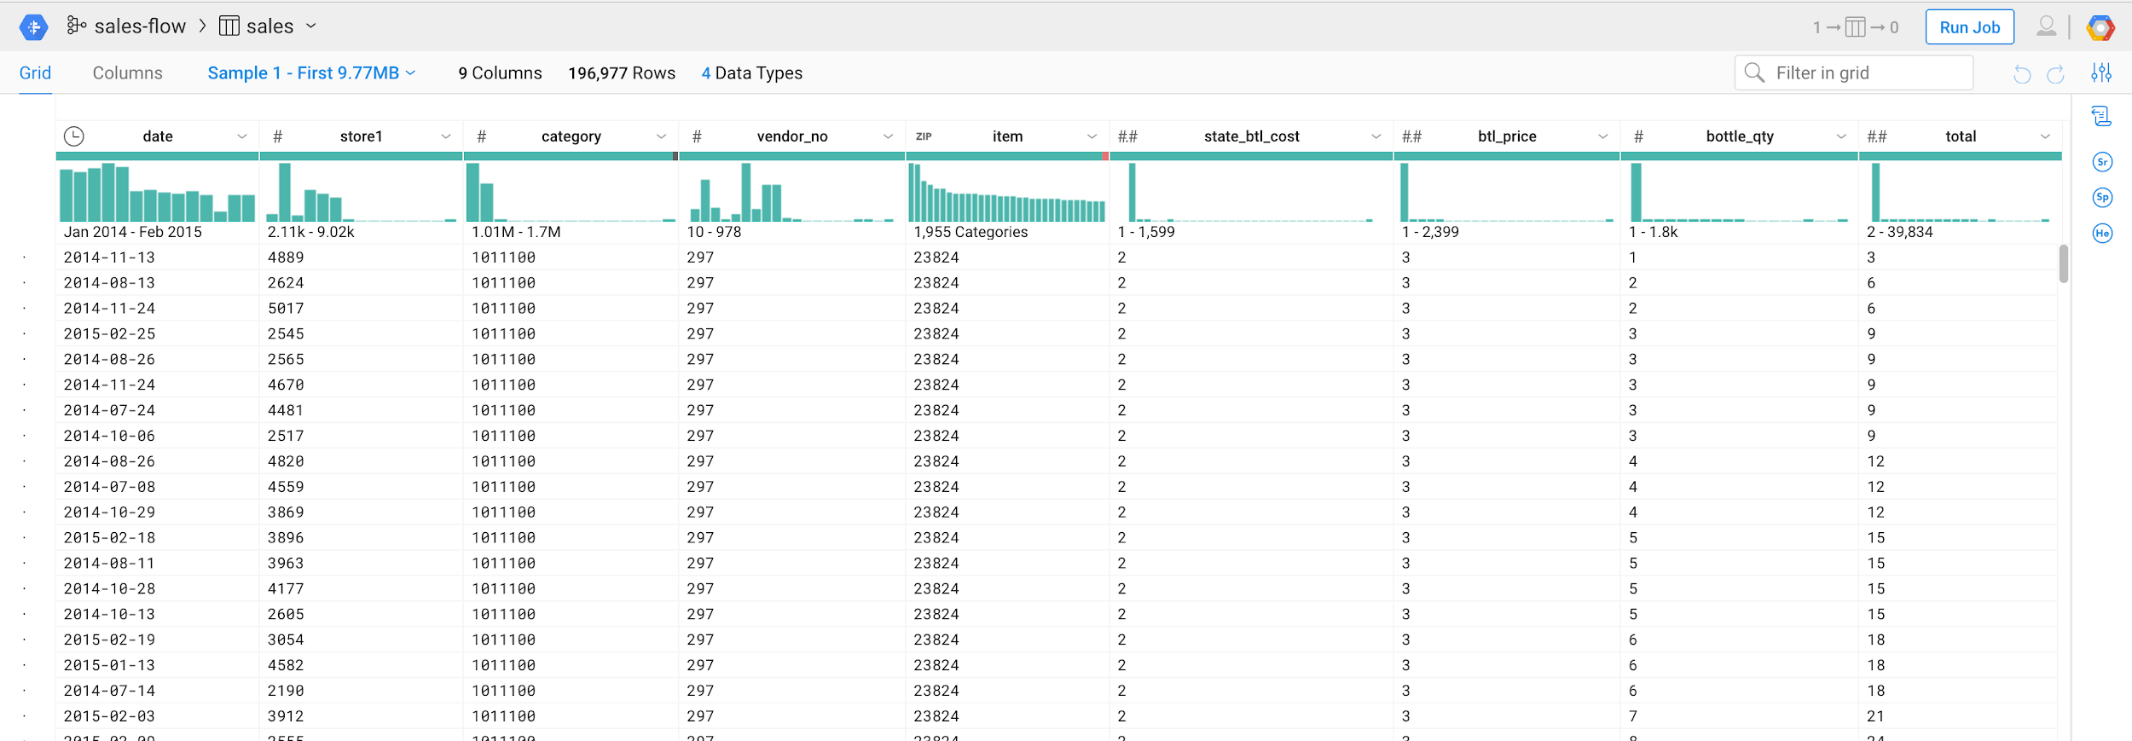
Cloud Dataprep
Visual tool for cleaning and manipulating data
Serverless, runs on top of Dataflow
Can process very large datasets

Slide 183
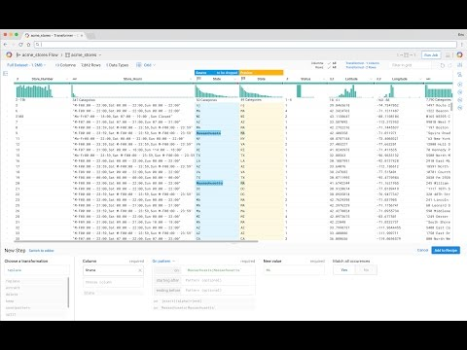
Demo: Dataprep Video

Slide 184
Chapter Concepts
Data Processing Architectures
Google Cloud DataFlow
Pub/Sub
Cloud Dataprep
Exam Prep

Slide 185
Links
Dataflow
Pub/Sub

Slide 186
Google Cloud Certification Workshop—Data Engineer
Chapter 8:
Analytics and Visualization

Slide 187
Chapter Objectives
In this chapter, we will learn how to:
Analyze data using Google Cloud Datalab
Create reports and visualizations using Data Studio

Slide 188
Chapter Concepts
Datalab
Data Studio
Exam Prep

Slide 189
Cloud Datalab
Things to know:
Interactive tool for data analysis, machine learning, and many other tasks
Based on Jupyter, an open-source project for creating iPython Notebooks
Supports many languages: Python, JavaScript, Shell scripts, HTML, SQL, etc.
Integrated with GCP, so access to other services like BigQuery are simple
Integrates with Git to enable collaboration and sharing notebooks
Runs in a Compute Engine Virtual Machine
No extra charge for Datalab beyond the machine cost

Slide 190
Managing Datalab Instances
Manage Datalab instances using the Google Cloud SDK in Cloud Shell
To create a Datalab instance: datalab create instance-name
To stop an instance without deleting it: datalab stop instance-name
To restart a stopped instance: datalab connect instance-name
To delete an instance: datalab delete instance-name
For more options and details on using the SDK see: https://cloud.google.com/datalab/docs/how-to/lifecycle

Slide 191
Do Now: Create a Datalab Instance
Log onto the GCP Management Console and go to a project (if you don’t have a project, create one)
Run the Datalab Quickstart
Before deleting the your Datalab instance, create a new notebook and enter code as shown on the following slide
Click the Run button after every code block

Slide 192
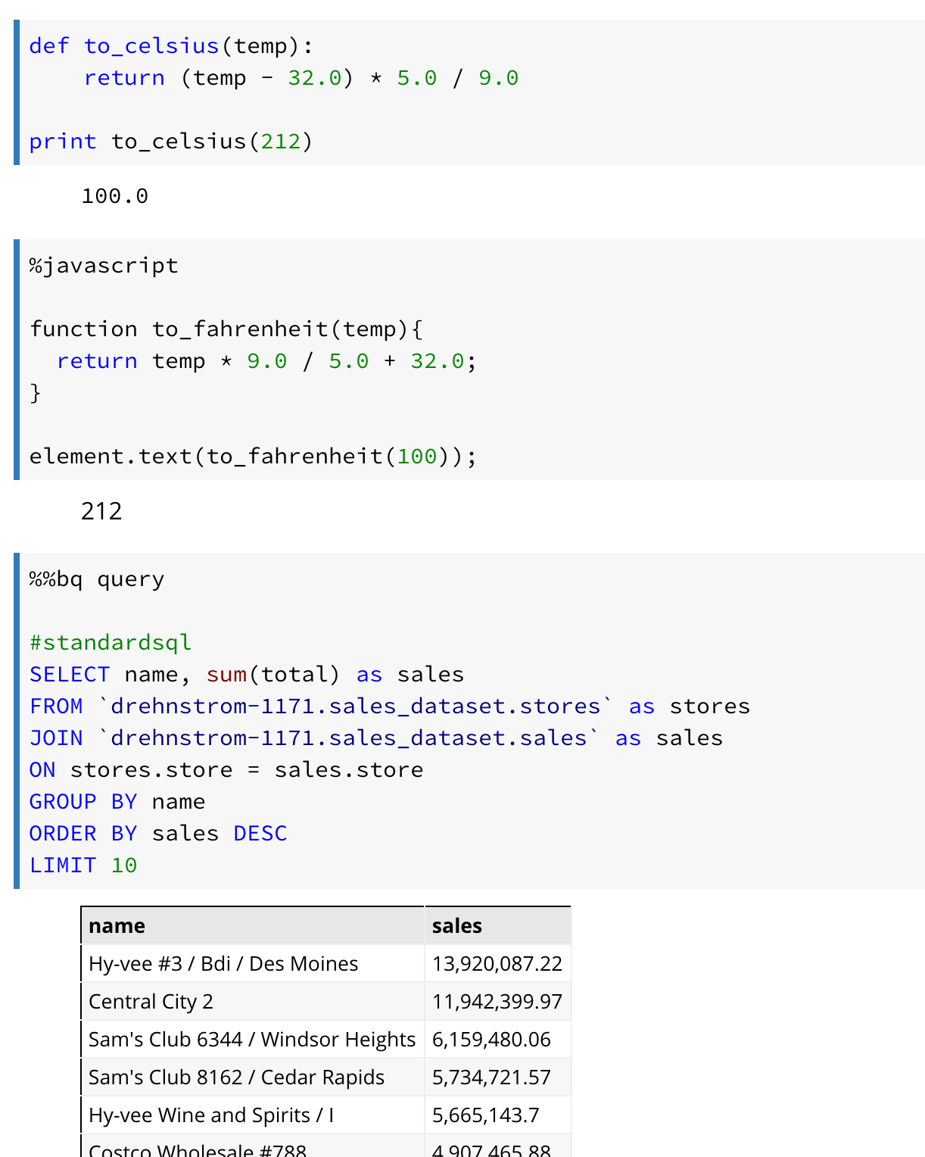
Do Now: Create a Datalab Instance (continued)
Copy-Paste code is shown in the Notes section below
Notes:
Copy-Paste Code:
####################
def to_celsius(temp):
return (temp - 32.0) * 5.0 / 9.0
print to_celsius(212)
####################
%javascript
function to_fahrenheit(temp){
return temp * 9.0 / 5.0 + 32.0;
}
element.text(to_fahrenheit(100));
######################
%%bq query
#standardsql
SELECT name, sum(total) as sales
FROM `drehnstrom-1171.sales_dataset.stores` as stores
JOIN `drehnstrom-1171.sales_dataset.sales` as sales
ON stores.store = sales.store
GROUP BY name
ORDER BY sales DESC
LIMIT 10

Slide 193
Chapter Concepts
Datalab
Data Studio
Exam Prep

Slide 194
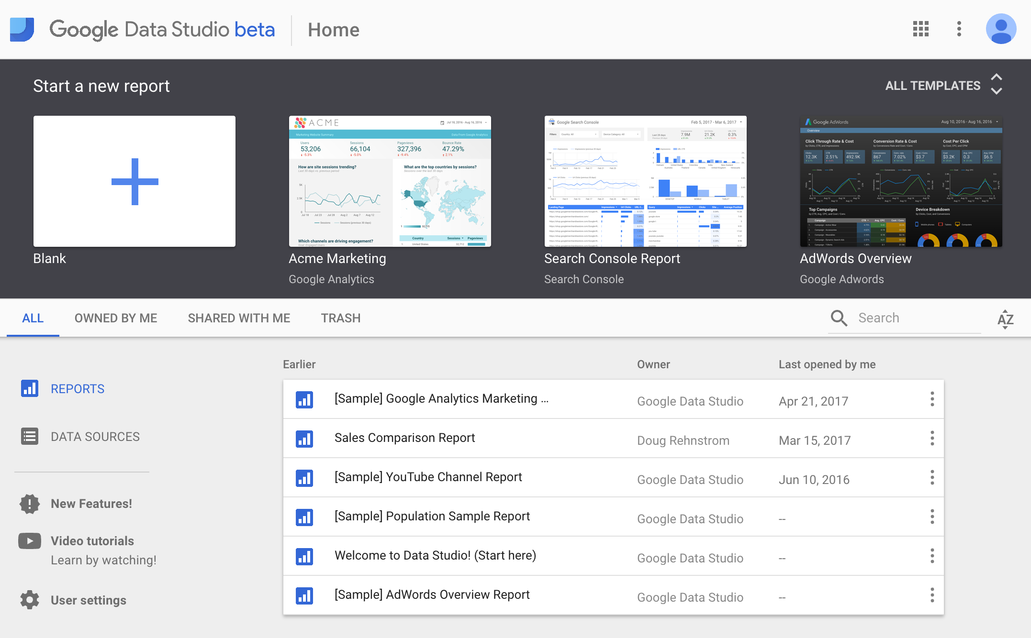
Google Cloud Data Studio

Slide 195
Data Studio
Things to know:
Reporting and visualization tool
Powerful chart and graphing tools built in
Nothing to install, runs in the browser
Supports many data sources
BigQuery, Cloud SQL, MySQL, Google Sheets, file uploads, and many more
FREE!

Slide 196
Do Now: Data Studio Examples
Go to the following URL and explore the examples: https://www.google.com/analytics/data-studio/gallery/

Slide 197
Chapter Concepts
Datalab
Data Studio
Exam Prep

Slide 198
Links
Datalab
Data Studio

Slide 199
Google Cloud Certification Workshop—Data Engineer
Chapter 9:
Machine Learning

Slide 200
Chapter Objectives
In this chapter, we will learn how to:
Build machine learning models
Choose Linear Regression, Classification, or Deep Neural Networks for different machine learning use cases
Write machine learning code using TensorFlow
Simplify and scale machine learning training with Google Cloud ML Engine
Leverage Google’s pre-trained machine learning models

Slide 201
Chapter Concepts
Machine Learning Overview
Machine Learning Algorithms
TensorFlow
Cloud MLE
Pre-Built ML Models
Exam Prep

Slide 202
Machine Learning
Programming computers to make decisions using non-traditional techniques
Algorithms are built based on math and statistics
Not if-statements and loops
Allows complex algorithms that would not otherwise be possible
Image and speech recognition
Sentiment analysis
Can be used to enhance and improve traditional algorithms
Google Search now uses machine learning as part of its algorithm
Spam detection has been greatly improved using ML

Slide 203
Machine Learning Steps
Gather data (lots of it)
Train the model
Calculate the accuracy of the model
Use the model
Repeat to improve the model accuracy

Slide 204
Gathering ML Data
A significant amount of data is required to do machine learning
Based on the data, can we find a problem we can answer?
Is a transaction fraudulent?
How much should a product cost?
Is an email spam?
Is there a cat in that picture?

Slide 205
Targets and Features
Historical data must have inside it a target and features
The target is what we want to train the computer to predict
Features will be the inputs that are used to build the model
For example, if the target is the price of an apartment, square footage might be one feature
What are other features be that could predict the price of a apartment?

Slide 206
Feature Tuning
Feature tuning is the process of analyzing the data to come up with good inputs for training a model
Is the feature relevant to the problem?
Are there anomalies or errors in the data?
Will the feature be known at run time?
Etc.

Slide 207
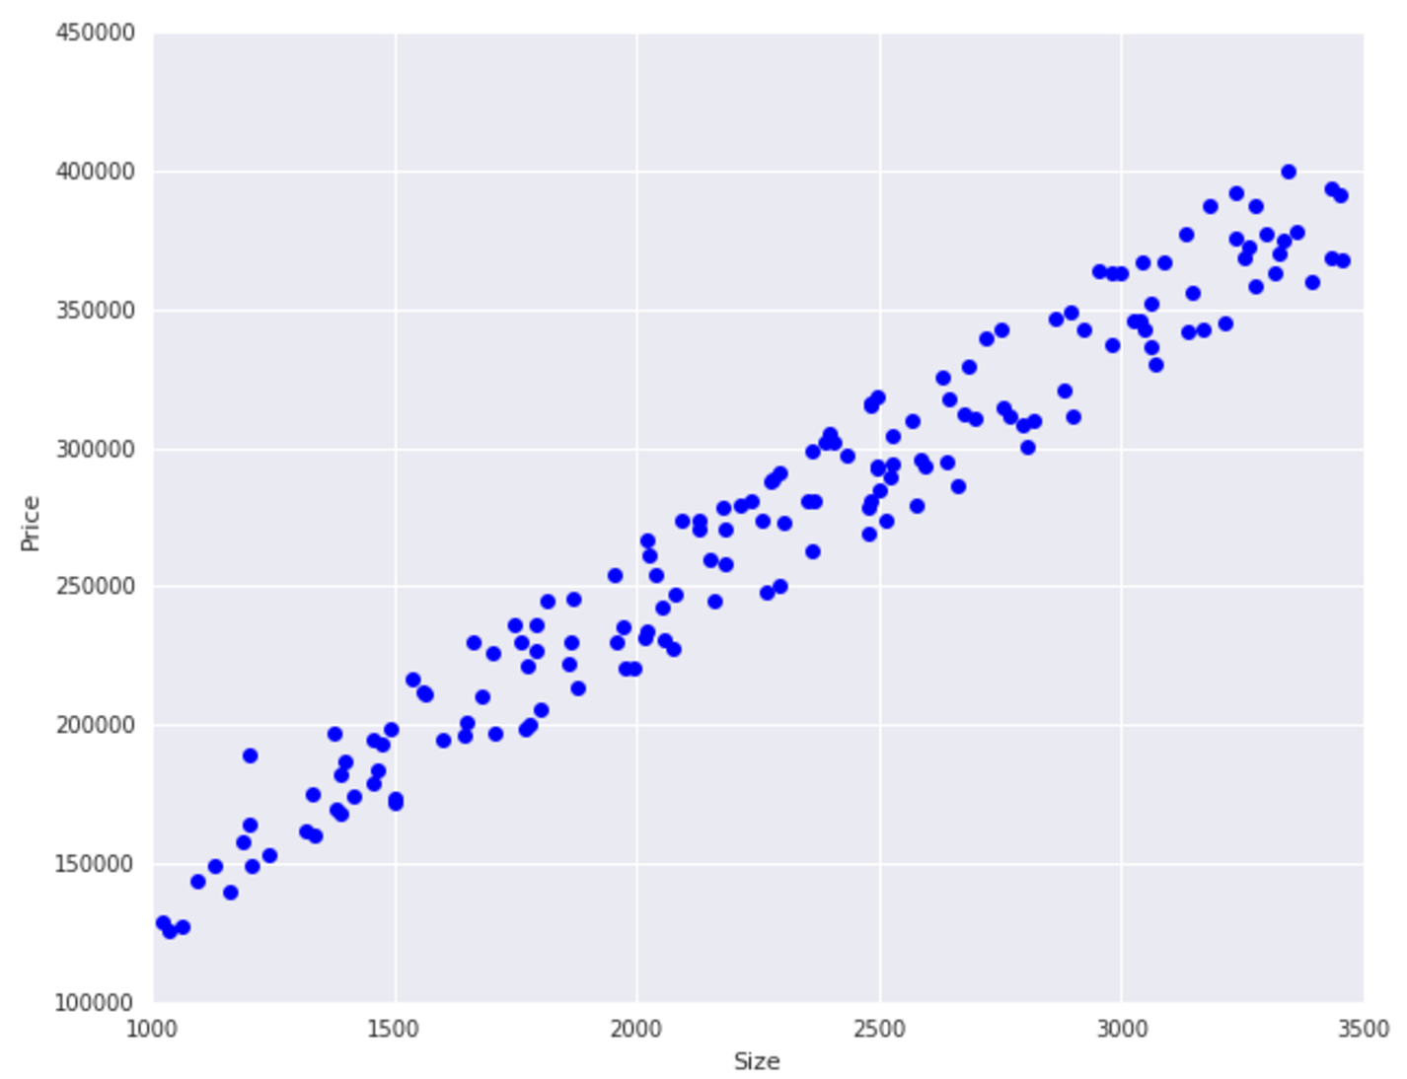
Gather Data
Start with some data

Slide 208
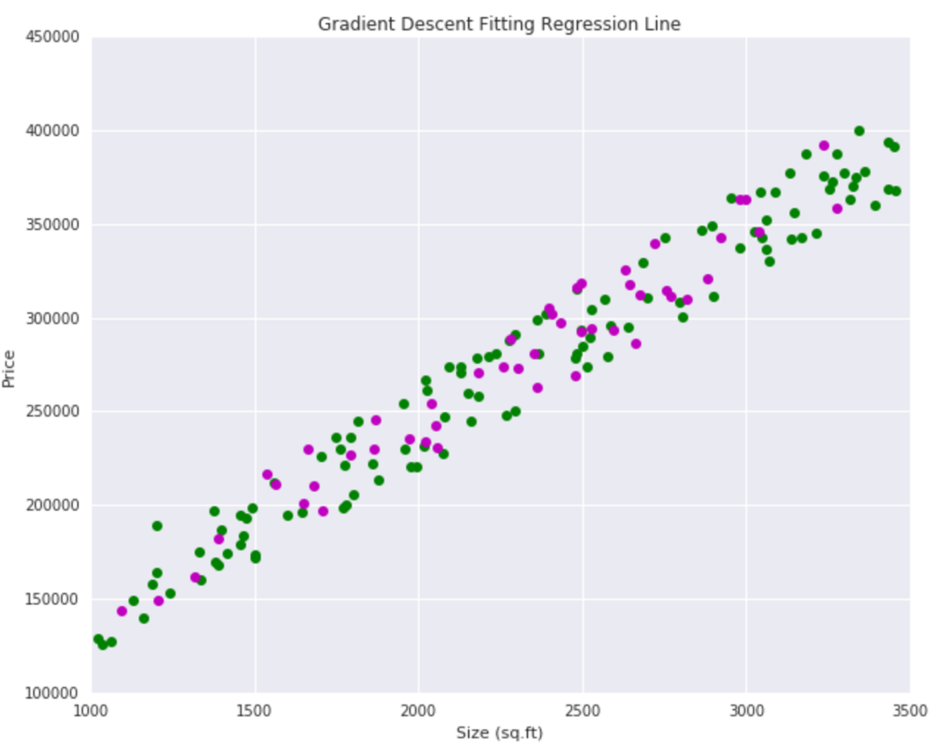
Split Data
2. Split the data into training and test data
The model is built with the training data
The model is evaluated with the test data

Slide 209
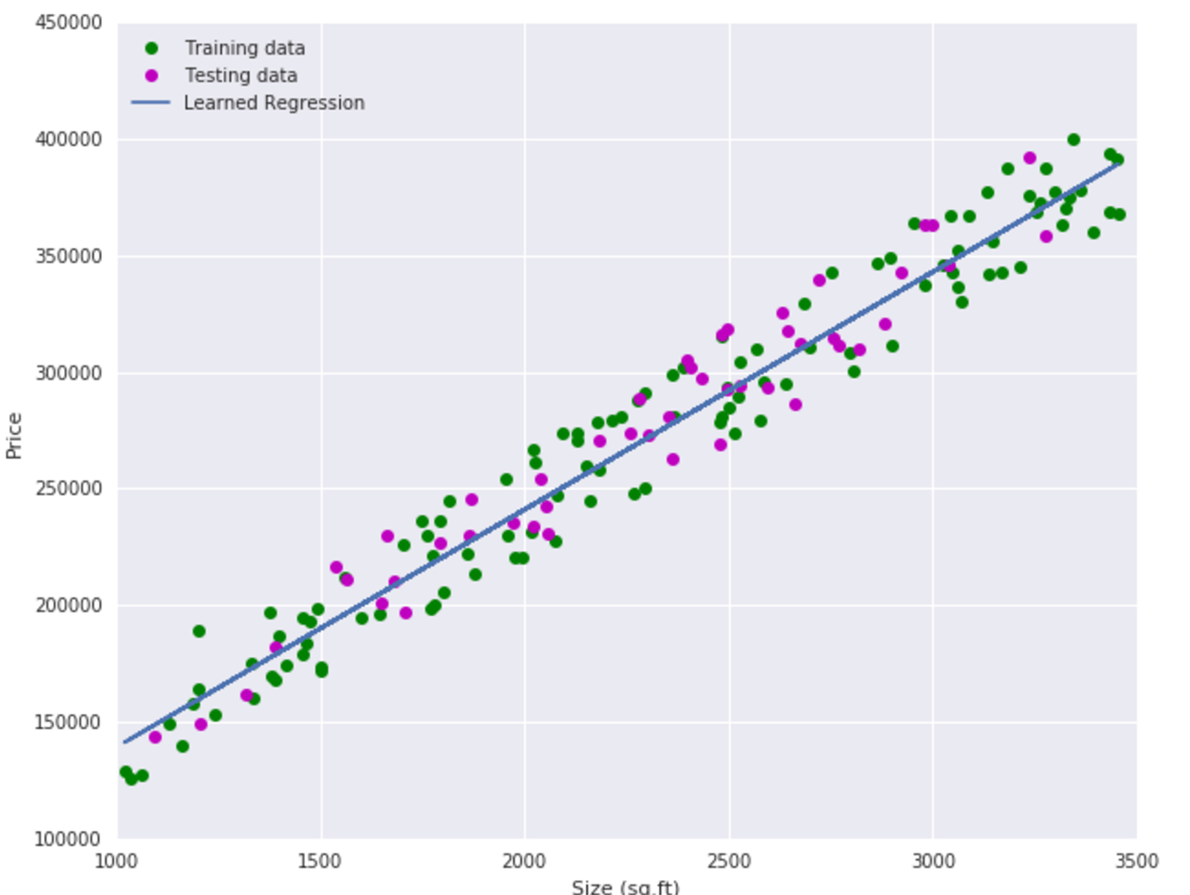
Train the Model
3. Draw a line
Calculate the accuracy of the line for both the training and test data
Draw the line over and over looking for the most accurate line

Slide 210
Calculating the Accuracy of Model (RMSE)
Need to calculate how accurate a line is
Calculate each point’s distance from the line
Some are positive and some are negative, so square them
Sum the squares
Divide by the number of points
This gives the Mean Squared Error (MSE)
Take the square root of the MSE (because the errors were all squared)
This gives Root Mean Squared Error (RMSE)

Slide 211
Gradient Descent
Technique is to find a line with the best fit
Keep moving the line slightly in one direction or the other
With each move, calculate the RMSE
If the RMSE goes down, move a little more in the same direction
If the RMSE goes up, move a little in the other direction

Slide 212
Weighing the Features
Each feature has an optimal line that fits the target
Different features can be given different weights
Some features are more important than others
The sum of the weighted features gives the prediction
There are a huge number of calculations required to build the model
That’s where the computer comes in!

Slide 213
Chapter Concepts
Machine Learning Overview
Machine Learning Algorithms
TensorFlow
Cloud MLE
Pre-Built ML Models
Exam Prep

Slide 214
Linear Regression
Used to predict a value along a curve
The apartment rental price example is linear regression
What are other examples of linear regression?

Slide 215
Classification
Used to predict whether the target is one of a finite number of values
Spam or not spam
Positive or negative comment
What is in the photo

Slide 216
Neural Networks
Neural networks consist of a collection of decision points
Each decision is called a neuron
Neuron are grouped into layers
The data passes from layer to layer
Each neuron makes one decision
The model assigns weights each neuron
Complex models can have huge numbers of layers and neurons
Training is used to adjust each neuron and assign the weights

Slide 217
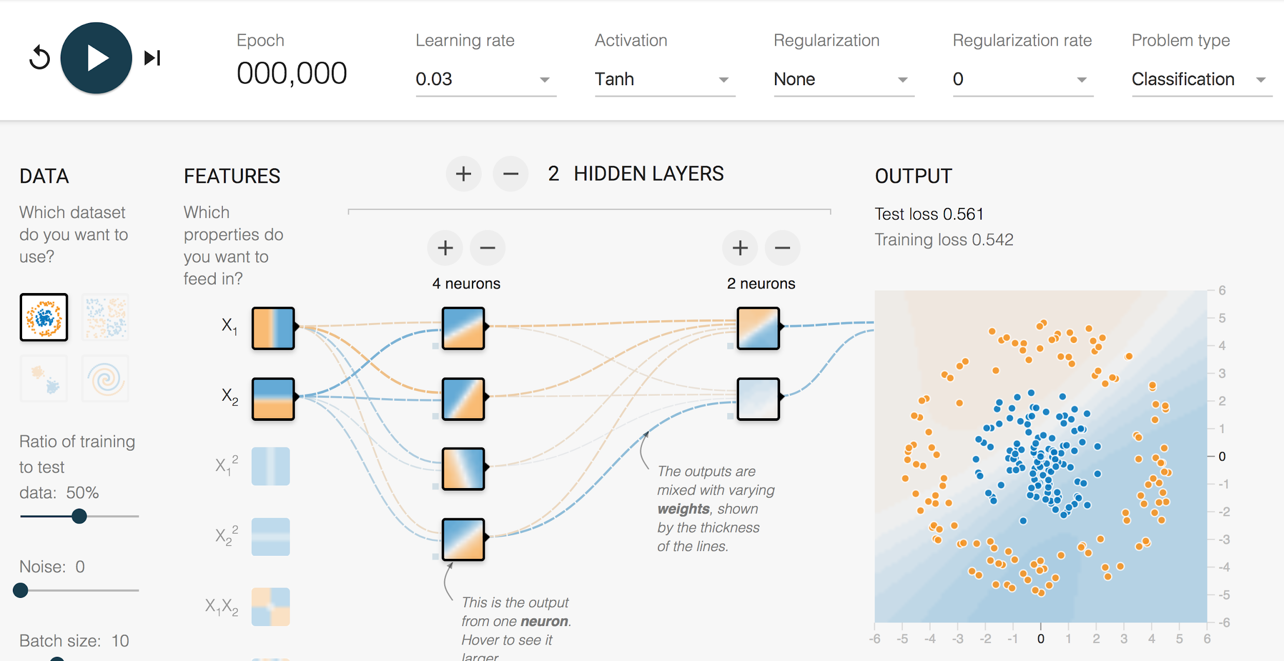
Demo: Neural Networks
Go to http://playground.tensorflow.org/

Slide 218
Chapter Concepts
Machine Learning Overview
Machine Learning Algorithms
TensorFlow
Cloud MLE
Pre-Built ML Models
Exam Prep

Slide 219
Machine Learning Frameworks
Building machine learning models requires advanced math and statistics
Different models require different algorithms and optimizations
Luckily, the math has been done and programmed into a number of machine learning frameworks
Allows machine learning models to be built without coding the math
Common ML frameworks include:
Scikit-learn
Spark MLlib
TensorFlow
And others

Slide 220
TensorFlow
Things to know:
Open-source library for machine learning originally created at Google
Used to train Google’s internal machine learning models
High-level API exposed Python API
Built on top of C++ library for speed
Runs on any platform, including mobile devices
The same code runs on CPUs, GPUs, or TPUs

Slide 221
Do Now: Basic TensorFlow Code
Click the URL below and read through the TensorFlow code Hello TensorFlow

Slide 222
Using TensorFlow to Train Models
model = tf.contrib.learn.LinearRegressor( feature_columns=make_feature_cols(), model_dir='./model_trained') model.fit(input_fn=make_input_fn(df_train), steps=5000);
def print_rmse(model, name, input_fn): metrics = model.evaluate(input_fn=input_fn, steps=1) print 'RMSE on {} dataset = {}'.format(name, np.sqrt(metrics['loss'])) print_rmse(model, 'validation', make_input_fn(df_valid)) print_rmse(model, 'training', make_input_fn(df_train))
results = model.predict(input_fn=lambda: predict_input_fn(predictions)

Slide 223
Exercises: Getting Started with Tensorflow
In these exercise, you will learn the basics of using Tensorflow for machine learning
Getting Started with Tensorflow
MNIST For ML Beginners

Slide 224
Homework: Learning Tensorflow
Using Google Cloud Datalab, do the following tutorials from the TensorFlow website:
Deep MNIST for Experts

Slide 225
Tensorflow Built-In Estimators
Estimators are used to construct the models
Inherit from the Estimator base class
All use in a similar way
Estimator | Description
LinearRegressor | Used to build a linear regression model
LinearClassifier | Used to build a classification model
DNNRegressor | Used to build a deep neural network for a linear regression model
DNNClassifier | Used to build a deep neural network for a classification model
DNNLinearCombinedRegressor | Combines LinearRegressor and DNNRegressor
DNNLinearCombinedClassifier | Combines LinearClassifier and DNNClassifier

Slide 226
Chapter Concepts
Machine Learning Overview
Machine Learning Algorithms
TensorFlow
Cloud MLE
Pre-Built ML Models
Exam Prep

Slide 227
Google Cloud ML Engine
Things to know:
Cloud-based service used to build machine learning models
Used by Google to build their own models
Fully managed NoOps service
Supports training on CPUs, GPUs, and TPUs
Can be used to deploy models as services
Command-line API for submitting jobs, deploying models, and making predictions

Slide 228
Cloud ML Command Examples
gcloud ml-engine jobs submit training my_job \ --module-name trainer.task \ --staging-bucket gs://my-bucket \ --package-path /my/code/path/trainer \ --packages additional-dep1.tar.gz,dep2.whl
gcloud ml-engine jobs submit prediction JOB --data-format=DATA_FORMAT --input-paths=INPUT_PATH,[INPUT_PATH,…] --output-path=OUTPUT_PATH --region=REGION
gcloud ml-engine models create MODEL [--enable-logging] [--regions=REGION,[REGION,…]] [GCLOUD_WIDE_FLAG …]

Slide 229
Homework: Learning Cloud MLE
Run the following tutorials:
Quickstart using the Command Line
Quickstart using Datalab

Slide 230
Chapter Concepts
Machine Learning Overview
Machine Learning Algorithms
TensorFlow
Cloud MLE
Pre-Built ML Models
Exam Prep

Slide 231
Using Google’s Pre-Built ML Models
Google has a number of already trained models that you can use today
Reasonably priced
Extremely fast
Simple, consistent coding
Prebuilt models include:
Vision API
Natural Language API
Speech API
Translate API
And others

Slide 232
Vision API Sample Code
from googleapiclient.discovery import build
import base64
IMAGE="gs://cpb103-public-files/noirbree.jpg"
vservice = build('vision', 'v1', developerKey=APIKEY)
request = vservice.images().annotate(body={
'requests': [{
'image': {
'source': {
'gcs_image_uri': IMAGE
}
},
'features': [{
'type': 'LABEL_DETECTION',
'maxResults': 100,
}]
}],
})
outputs = request.execute(num_retries=3)

Slide 233
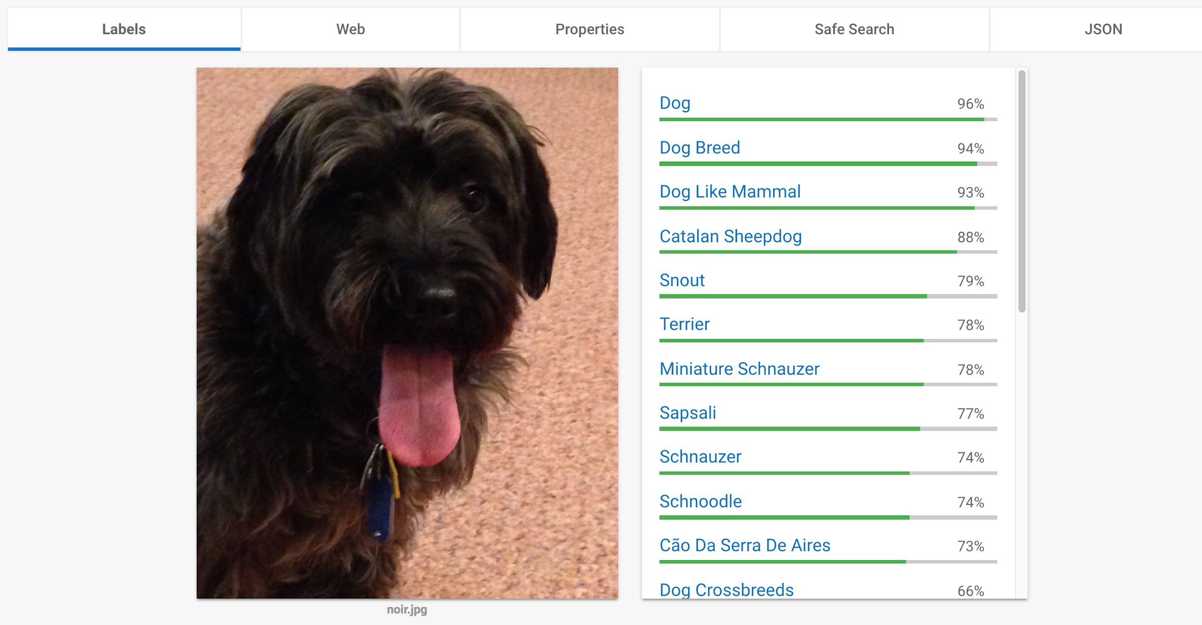
Vision API
https://cloud.google.com/vision/

Slide 234
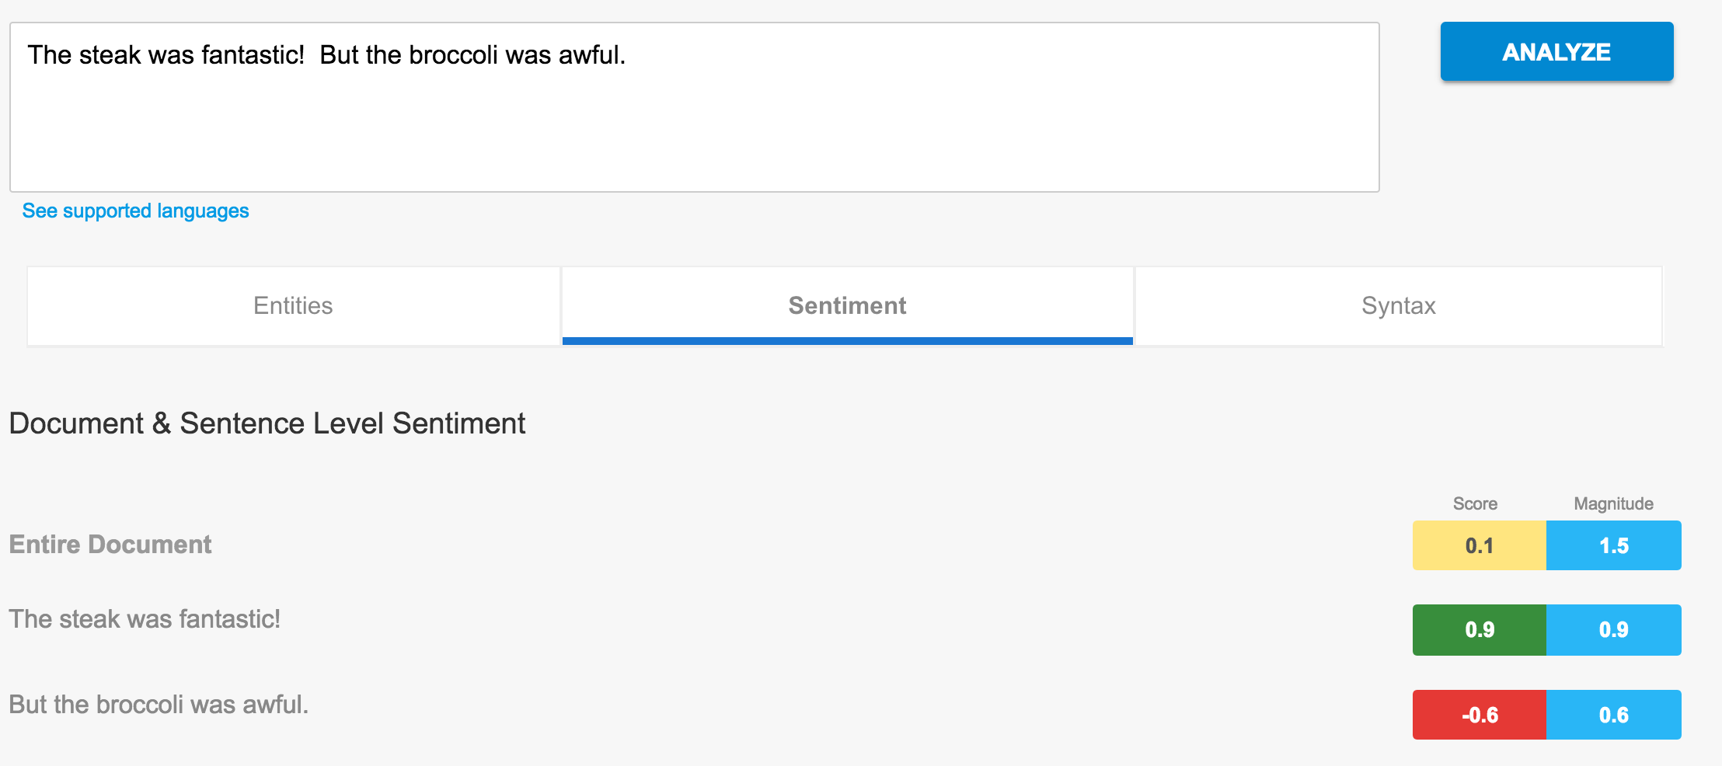
Natural Language API
https://cloud.google.com/natural-language/

Slide 235
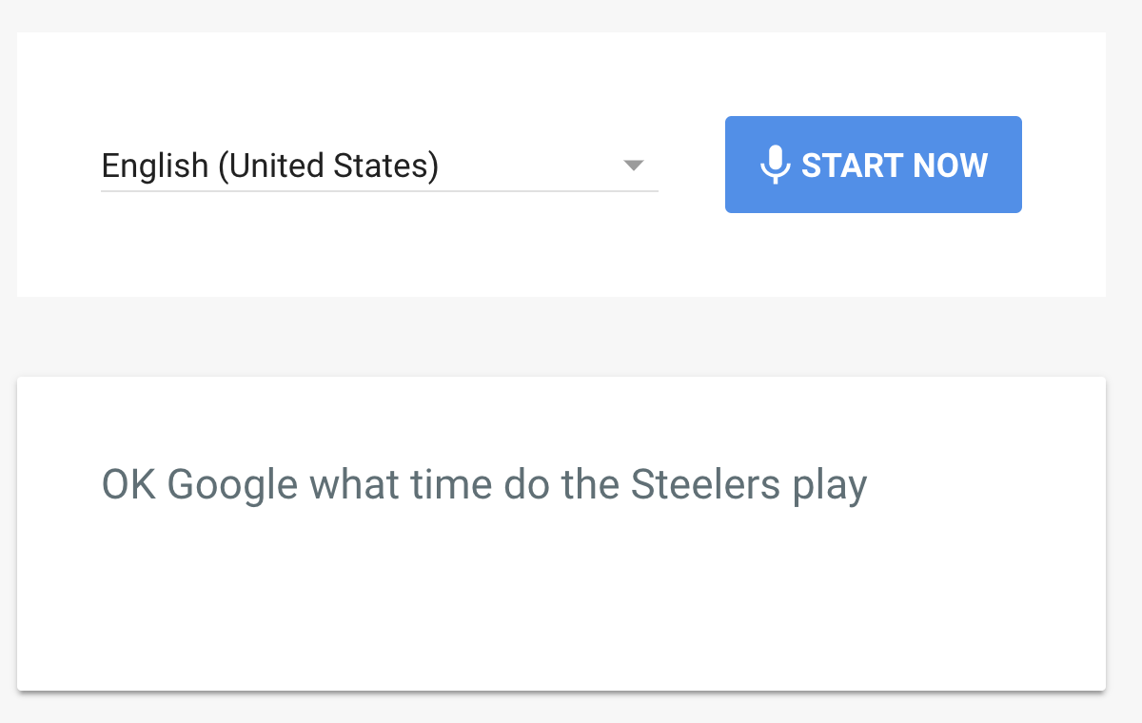
Speech API
https://cloud.google.com/speech/

Slide 236
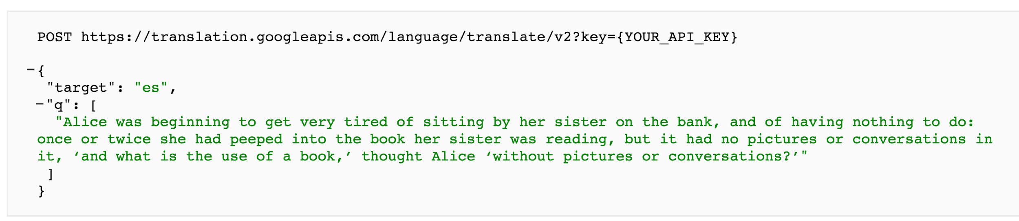
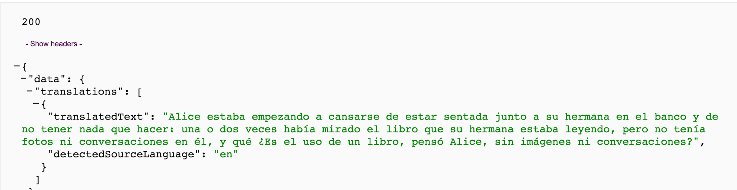
Translate API
https://cloud.google.com/translate/

Slide 237
Exercise: GCP Machine Learning
In this exercise, you will use Google's pre-built machine learning APIs
GCP Machine Learning Pre-Built Models

Slide 238
Chapter Concepts
Machine Learning Overview
Machine Learning Algorithms
TensorFlow
Cloud MLE
Pre-Built ML Models
Exam Prep

Slide 239
Do Now: Practice Quiz
Take this practice quiz

Slide 240
Google Cloud Certification Workshop—Data Engineer
Chapter 10:
Case Studies

Slide 241
Chapter Objectives
In this chapter, we will:
Review the case studies you need to know for the GCP Certified Data Engineer exam

Slide 242
Case Study
Read the following case study: Flowlogistic
List below some Google Cloud Platform Services that would be used when implementing this case study

Slide 243
Case Study
Read the following case study: MJTelco
List below some Google Cloud Platform Services that would be used when implementing this case study

Slide 244
Practice Exam
Take this practice exam

Slide 245
Google Cloud Certification Workshop—Data Engineer
QwikLabs Quest

Slide 246
Data Engineering Quest
Complete the Data Engineering Quest provided by Qwiklabs
Go to: Data Engineering Quest
If you do not already have a QwikLabs account Join
Enroll in this Quest

Slide 247
Google Cloud Certification Workshop—Data Engineer
Homework

Slide 248
Links
The Great AI Awakening
Dataproc
BigQuery
Dataflow
Apache Beam
TensorFlow
Google Cloud ML Engine

Slide 249
Videos
TensorFlow and Deep Learning without a PhD
Effective TensorFlow for Non-Experts
Introduction to Google Cloud Machine Learning
Coursera Machine Learning Course
Big Data and Machine Learning Fundamentals

Slide 250
Tutorials
Google Cloud Storage Disks and Snapshots Cloud SQL Quickstart Cloud Spanner Quickstart Datastore Quickstart Creating Dataproc Clusters GCP Dataproc: Running Hive and Spark Jobs | Querying Data with BigQuery Dataflow Quickstart using Python Dataflow Quickstart using Java Getting Started with Tensorflow MNIST For ML Beginners Deep MNIST for Experts

Slide 251
Google Cloud Certification Workshop—Data Engineer
Course Summary

Slide 252
Course Summary
In this course, we have learned how to:
Prepare for the GCP Data Engineer certification exam
Choose the appropriate GCP data storage solution
Architect batch and streaming data processing pipelines on GCP
Leverage GCP tools for data manipulation, analysis, and visualization
Build machine learning models with GCP tools
Analyze case studies to optimize data storage and processing solutions

Slide 253

Looking for more training or training for your team?
Visit google.roitraining.com or email us directly at GoogleOps@roitraining.com
Be sure to check out the rest of Google’s Cloud Curriculum below
Cloud Infrastructure
Data and Machine Training
Application Development
Other Course Offerings
Google Cloud Fundamentals: Core Infrastructure
Google Cloud Fundamentals: Big Data and Machine Learning
Google Cloud Fundamentals: Core Infrastructure
Getting Started with Google Kubernetes Engine
Architecting with Google Cloud Platform: Infrastructure
Data Engineering on Google Cloud Platform
Developing Applications with Google Cloud Platform
758: Migrating to the Cloud - Sales Workshop
Architecting with Google Cloud Platform: Design and Process
From Data to Insights with Google Cloud Platform
Getting Started with Google Kubernetes Engine
797: Google Cloud Platform Launchpad
Google Cloud Certification Workshop: Cloud Architect
Google Cloud Certification Workshop: Data Engineer
Developing Applications with Google Cloud Platform
Build a Business Transformation Vision with Google Cloud
Google Cloud Certified Professional - Cloud Architect
Google Cloud Certified Professional - Data Engineer
Build a Business Transformation Vision with Google Cloud
20% off for ROI Alumni with Offer Code: ALUMNI
Google Cloud Student Resource Group on LinkedIn

